Slide 2
WHY TIME DOES (NOT) MATTER
J. DE Smit & S. NeusUESS

Slide 3
WHO WE ARE
We are OPTIVER
Electronic market maker.
Founded 1986 (single trader in Amsterdam).
1100 colleagues worldwide.
Investing our own capital at our own risk.
Committed to become carbon negative.
Notes:
Liquidity is the lifeblood of financial markets. Our job is to keep it flowing. We do so with our own capital, at our own risk, by constantly providing competitive bid-ask prices across a range of financial products: derivatives, cash equities, exchange-traded funds, bonds and foreign currencies.
Sebastian: 20 year veteran of the financial industry, joined Optiver this year
Jens: 7 years with Optiver and counting, transformed from developer into network capture and timing expert

Slide 4
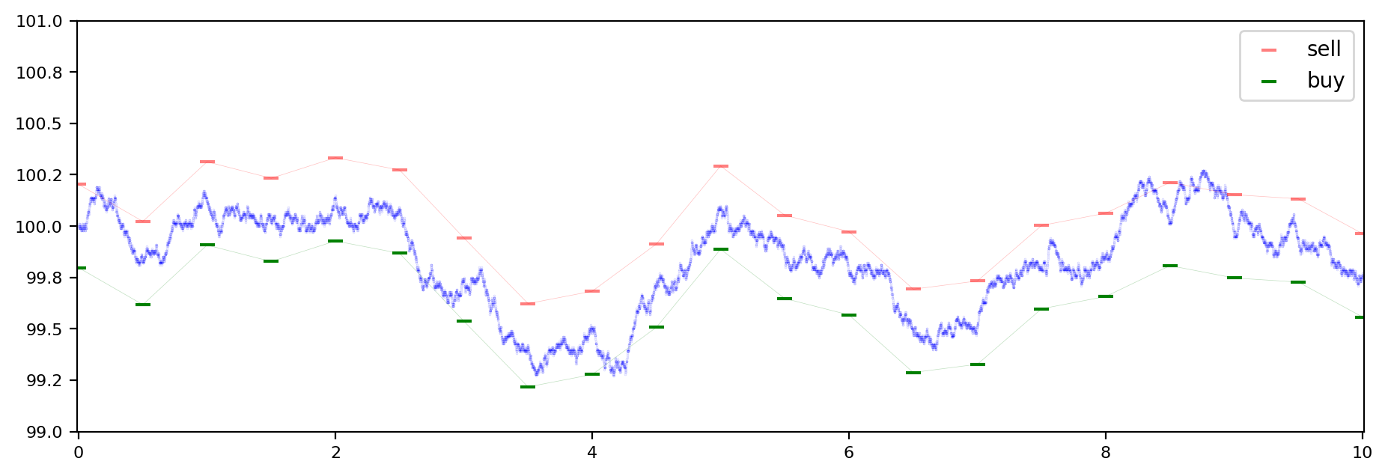
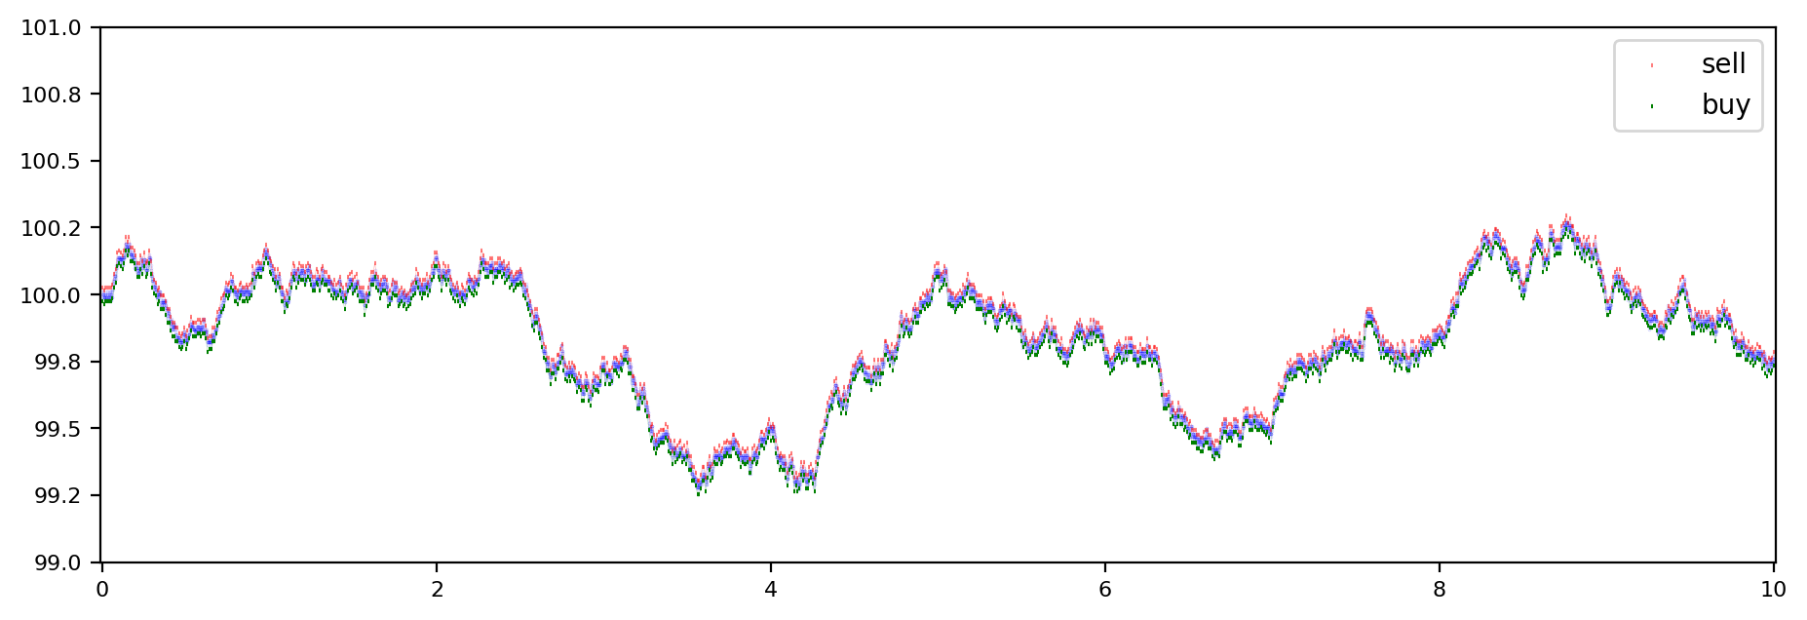
WHAT WE DO
ELECTRONIC MARKET MAKING
Providing liquidity in financial markets.
Willing to buy and sell at market prices (even when others may not be).
Improving markets.
Notes:
Punchline liquidity – what does it mean ?
Buy sell in many many instruments (number?) on numerous markets worldwide
Electronic ? => we use computers to do so
Improve Markets, all very nice but how do we end up at a time synch conference and what got time to do with it
=> Sebastian take over
Providing liquidity inhibits risk as the price may change rapidly
First graph showing a market maker who is updating at relatively low update frequency
As prices may change in these intervals the distance between buy and sell (we refer to this as the spread) is relatively large to avoid risk of a wrong price
Reducing the interval between these updates allows us to reduce the distance between our buy and sell orders, we call that ‘tighten the spread’.
--- https://wearemarketmakers.com/explore-market-making/
Being quick enough to provide this service and, at the same time, benefit from the (albeit tiny) spread is where we largely earn our keep. But it’s a narrow margin business, which means we need to be constantly on our toes, offering the right prices across many markets and products, and all at the same time.
The effect is visible to the market, as the bank of England recently stated that spreads have reduced 10fold in the last decade
In one word: Faster market making = potentially better markets.

Slide 5
TRADING
WHY TIME MATTERS
Price
Sell 10 for 101
A: Buy 10 for 100.1
Sell 10 for 100.1
B: Buy 10 for 100.1
Buy 10 for 100
Notes:
Orderbook – offers to buy or sell an instrument.
We as market makers are providing an offer to buy and sell – with a certain spread to cover our risk of sudden price moves.
Having said that we might be willing to buy higher / sell lower than the orders we show in the orderbook.
So when an order comes into the orderbook we want to trade it, in this example we then send a buy order for 100.1.
At the same time other market participants may also want to trade against this order, so we have a competition for this trade opportunity.
On almost all exchanges the order entering the matching engine of the exchange first gets the trade, whereas the second order gets no trade at all.
This is a typical race situation, so let us look at a typical sports race to understand the principles

Slide 6
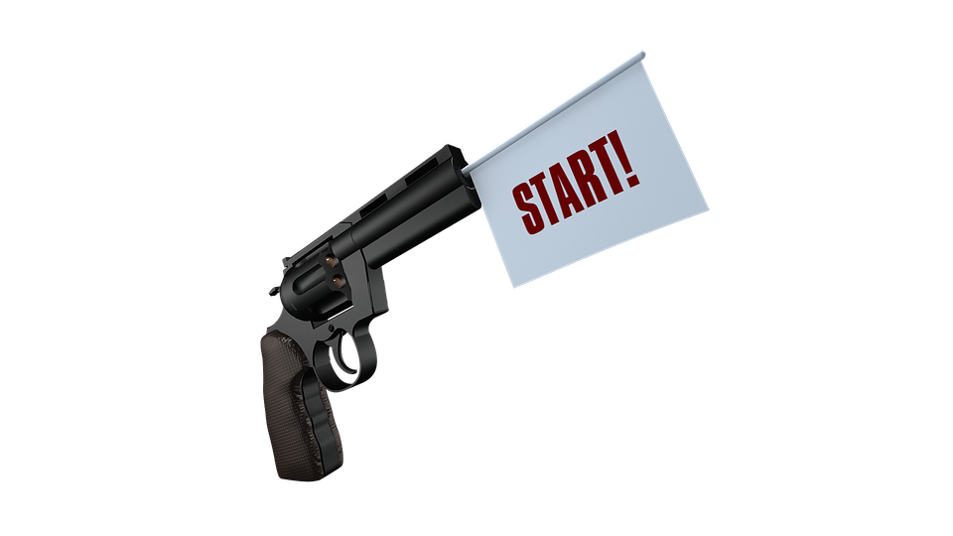
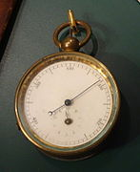
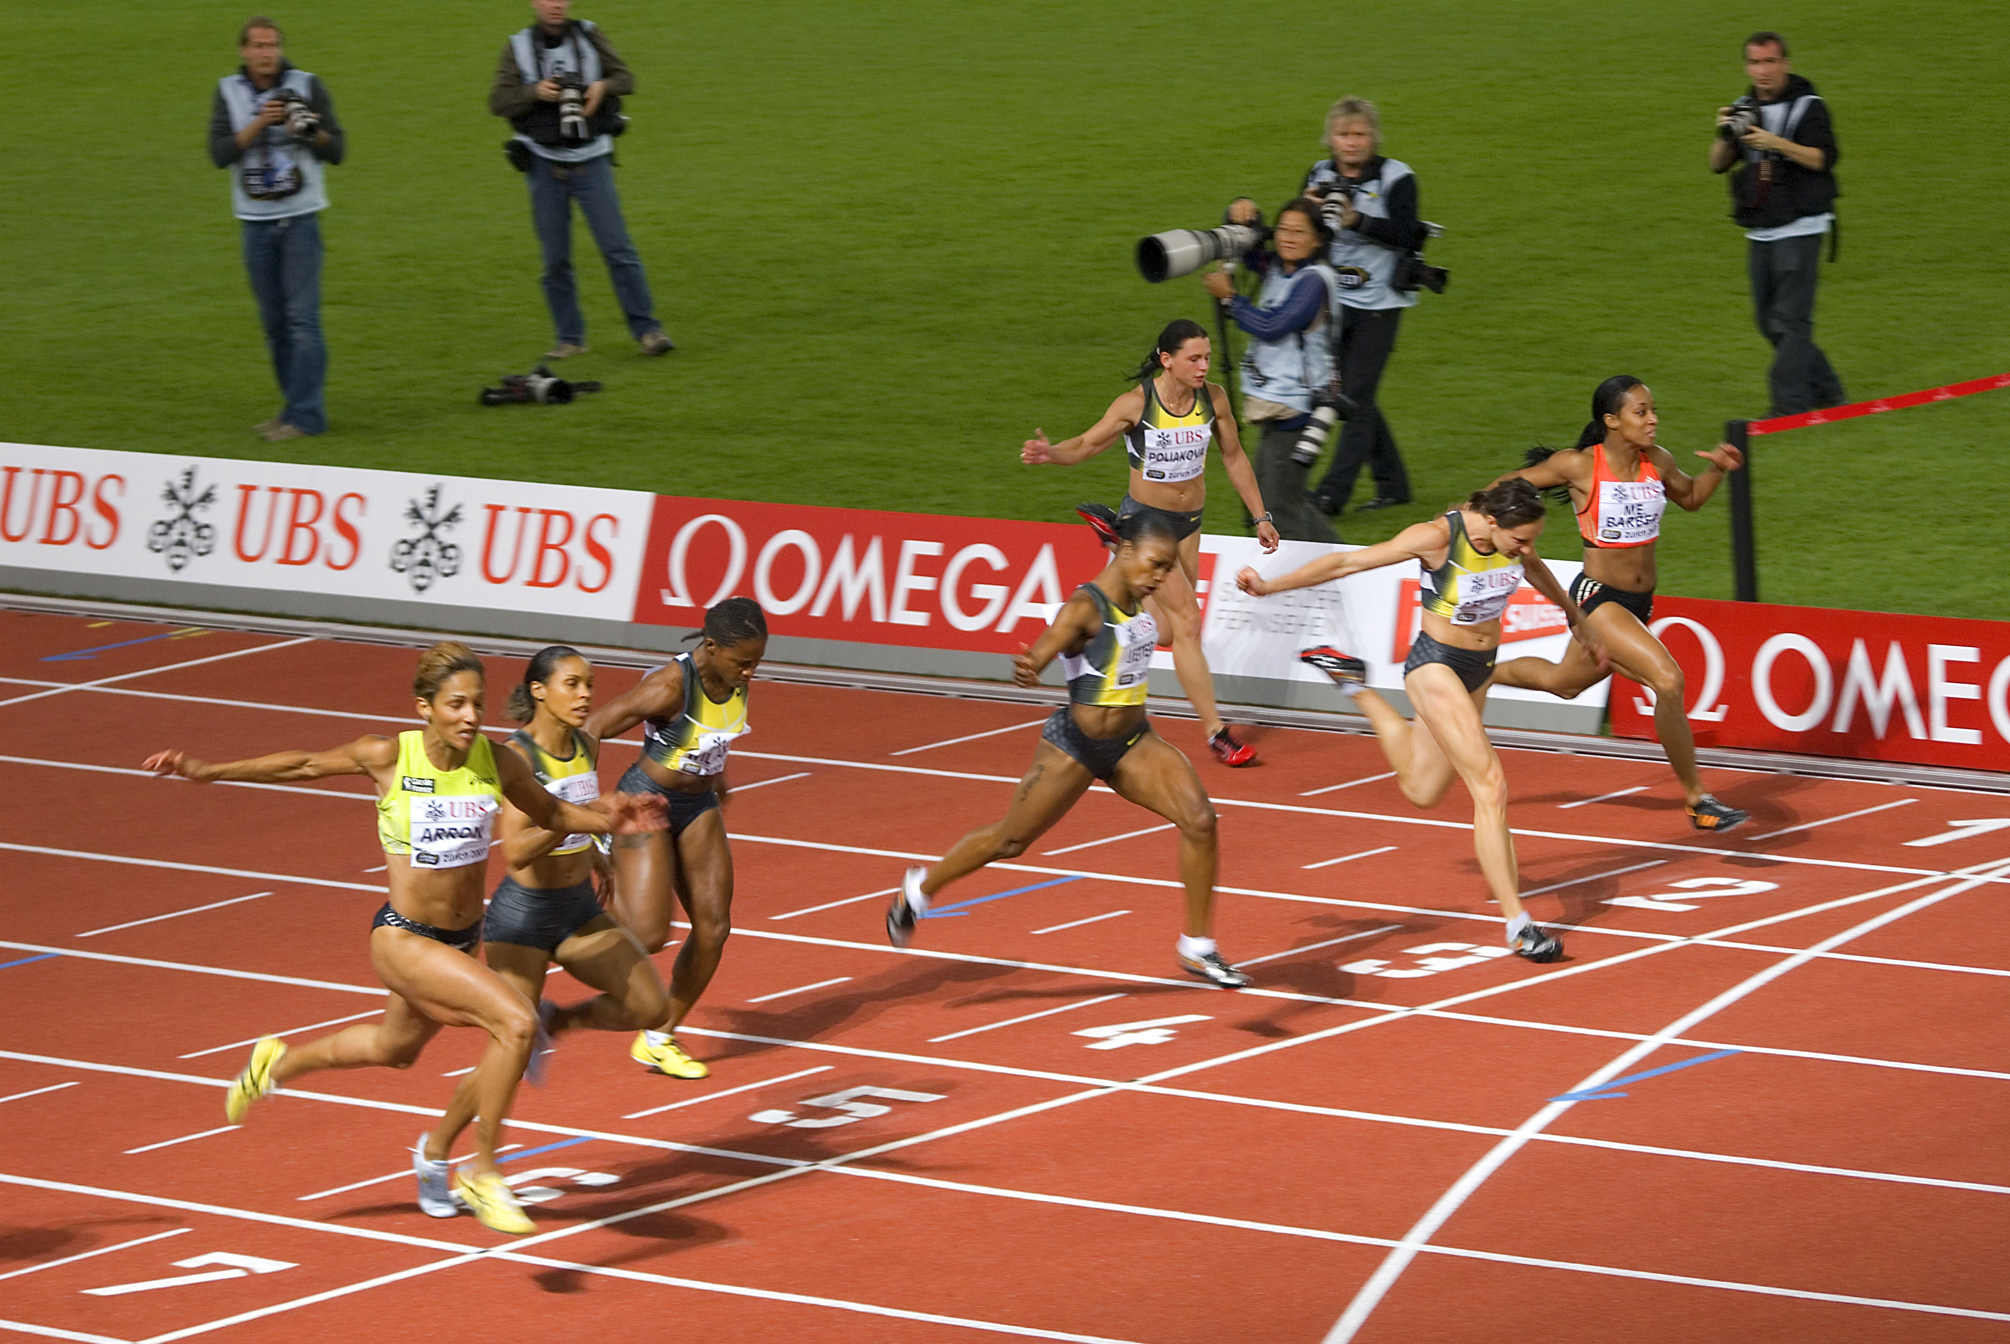
Latency
The Race
https://cdn.pixabay.com/photo/2017/10/26/14/51/start-2891328_960_720.png https://upload.wikimedia.org/wikipedia/commons/thumb/2/23/Stopwatch_A.jpg/640px-Stopwatch_A.jpg https://upload.wikimedia.org/wikipedia/commons/thumb/8/8a/100m_women_Golden_League_2007_in_Zurich.jpg/800px-100m_women_Golden_League_2007_in_Zurich.jpg
Notes:
A track race is usually started with a starting gun. Upon firing the time measurement starts, and time is stopped when runners cross the finish line.
What kind of times are we talking about,
100 m race ~ 10 seconds, 800 m race 1 minute 40 seconds
In finance we call that the latency
What kind of precision does the measurment require => depends very much on the distance between the runners at the finishing line.
Photo finish – up to 20000 frames per second => 50 micros
May be overlooked: Do all starters get the signal at the same time?
speed of sound is ~ 300 m/s, if pistol is fired at the side of the race track the difference between first and last one getting it is about 7*1.22 m / 300 = 28 ms
Solution: Loudspeaker behind each starter at equidistance
To avoid this problem, the pistol is in all major competitions wired with a microphone that transmits the sound virtually instantaneously to loudspeakers directly behind each competitor.
------------------
Next slide: What time does matter the least here?

Slide 7
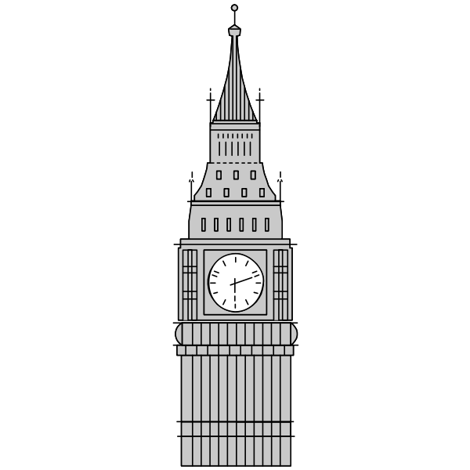
WE DON’T CARE ABOUT TIME
EXCEPT WE DO
Notes:
Wallclock time ? That does not really matter that much (some runners prefer evenings, other mornings)
https://www.live-karikaturen.ch/wp-content/uploads/2020/04/big-ben-palace-of-westminster-london-grossbritannien-zeichnung-comic-cartoon-agnes-karikaturen-hd-wm.jpg

Slide 8
Trading
TIMES
Event
Difference
>1000 ns
Difference
0-10 ns
Reaction time
~ 15 ns*
Difference
sub ns
Difference
>100 ns
* See https://www.eurexchange.com/resource/blob/48918/1975b3b92d15741d4e72d359dffaa7e5/data/presentation_insights-into-trading-system-dynamics_en.pdf
Notes:
Trigger to trade similar to a race, doesn’t really matter at which point in time it starts, but latency between start and end matter The sequence of racers at the finish line matters.
Time deltas at network level in ns range (multicast predominant).
Reaction times of traders in the 10s of ns, differences in reaction times ns (soon sub ns?)
Handover to Jens for the implementation side

Slide 9
Time sync implementation
In the data center
Exchange switches
Ethernet
Optiver switches
Exchange switch
Network capture
PPS
Network captures w/ timestamping
Network capture
Central clock
Notes:
What does this look like physically? To each exchange, we connect physically with 10G Ethernet. _All_ traffic is timestamped and capture for later analysis.
We need to always know how well we’re doing in the race. Even if we’re not winning, we need to know if we’re close. We also need to know if the race is fair.
For all that, we use the timestamps on the network capture.
Often, we have many network lines between us and the exchange, both for redundancy and for scaling reasons. This requires multiple capture/timestamping devices, hence synchronization to be able to compare timestamps across devices.

Slide 10
Advanced time sync implementation
With the exchange
Exchange switches
Ethernet
Optiver switches
Exchange switch
Network capture
PPS
Network captures w/ timestamping
Network capture
Network captures w/ timestamping
Network capture
Central clock
White Rabbit
Notes:
Many exchanges do exactly what we do: capture all network traffic and analyze it. It’s what Sebastian did at Deutsche Boerse.
To varying extents, exchanges share these timestamps with us, giving deeper insight into the whole path of the race. However, usually it’s unclear how the 2 parties (dis)agree on what the wallclock time is.
Some choice exchanges actually _expose_ their idea of time of day through offering a White Rabbit cross-connect.

Slide 11
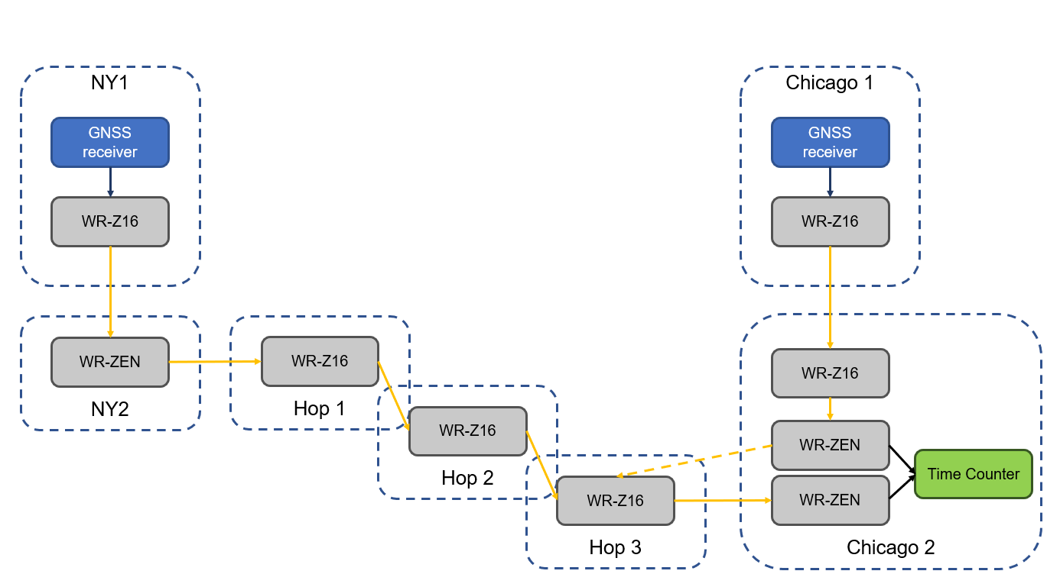
TIME SYNC implementation
BETWEEN LOCATIONS
Sad truth – long range accurate time sync is hard
Easiest fairly accurate solution is… TAI/UTC through GPS
Interesting case study: 6-hop White Rabbit link between New Jersey and Chicago
Image source: Seven Solutions
Notes:
This is very different from in-colo time synchronization, and also takes a second seat.
So, even though we don’t really care about UTC that much, it’s the best thing that is universally available
Getting a GPS very right is a lot of work, like accurately knowing antenna lead delay. Even then, your variance will typically be in the 10s of nanos.
We’ve tried long distance PTP, but that suffers too much from network congestion, crappy hardware, link asymmetry…
How to measure the skew between locations? We’d like to know!

Slide 12
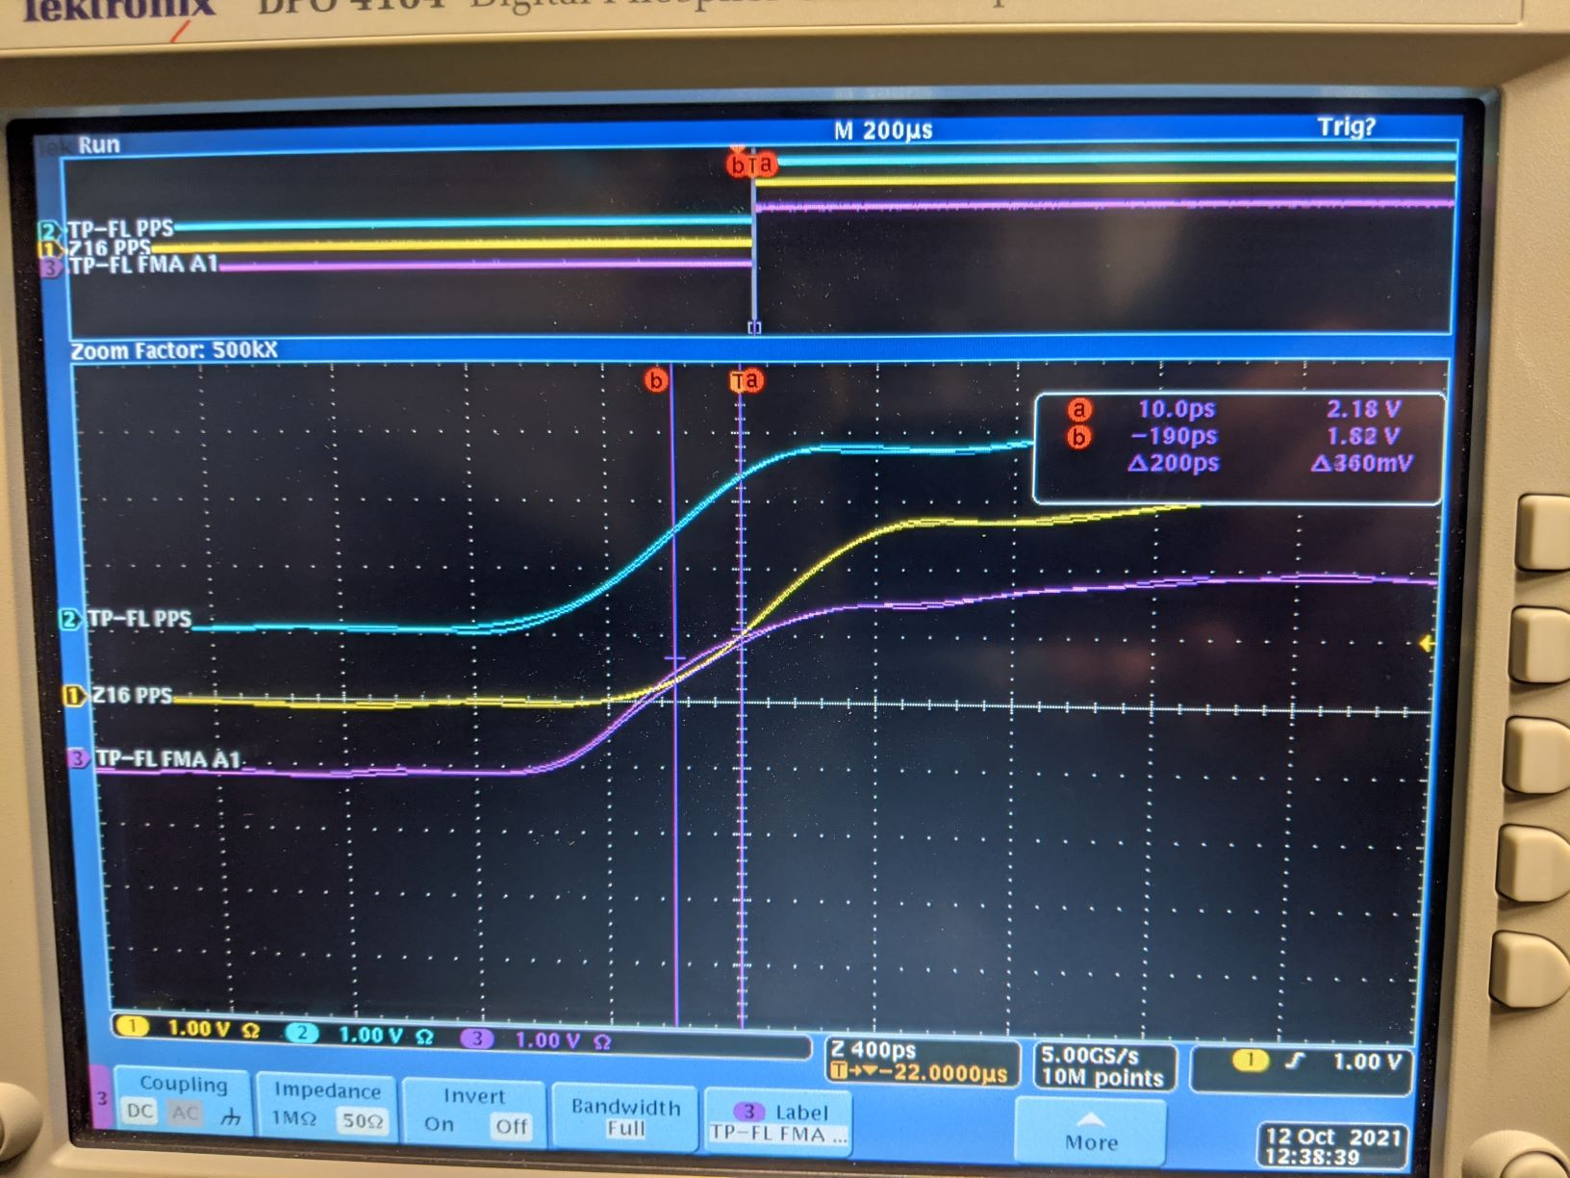
Challenges
What is hard?
Accounting for propagation delay
Detecting deviations
Installation, sometimes
Scale
Dealing with multiple parties’ idea of time
Notes:
This is where we like to discuss with you
Accounting for prop delay requires painstaking measurements and administration
Detecting deviations (esp. in a far away production deployment) is hard: how does one monitor PPS in the first place, and which device is at fault if you find an anomaly?
Installation: remote deployment is hard, esp. with engineers that are focused on networking
Scale: PPS/time code outputs are scarce, and signal degrades quickly with distance
Multiple ideas of time: we are not the only party that cares way more about super accurate internal sync than sync vs UTC – but we _also_ would like to compare timestamps between us
Handover to Sebastian to summarize

Slide 13
Sync REQUIREMENTS
WHAT WE WANT - synchronicity
Trade
ns
00’ ps
00’ ps
ns
ns
ns
0’ ns
Notes:
Ideally exchange timestamp within one exchange should be synched with ns precision. Handover points to clients should ideally be synched down to hundreds of picos, though this may vary from exchange to exchange. Sync between exchange and their trading participants should be available on nanosecond Finally it would be beneficial to sync exchange times to the 10s of nanoseconds, at least where they are in close physical distance from each other.
We want exchanges to have highly accurate and precise timestamps, ideally offering their time via whiterabbit signals to us.

Slide 14
THE GIST
TIME DOES MATTER
Speed is a matter of risk management: Faster market makers lead to better prices.
Time differences in the range of picoseconds matter.
Accurate timestamps enable monitoring.
Monitoring enables transparency, fairness and predictability.
Time sync and measurement at sub nanoseconds is non trivial.
1 nanocentury ≈ $π$ seconds.
Notes:
If you have a solution we would like to hear from you, and please also talk to the exchanges

