Slide 1





Timing Convergence in Power Utilities
Power Utilities are migrating to digital, fully automated substations connected by means of optical Ethernet networks. The IEC 61850 standard defines a set of Ethernet-based protocols, such as GOOSE and SV to transport critical data that requires accurate timing that can be provided by PTP that has also been adopted by this industry.
.

Slide 2

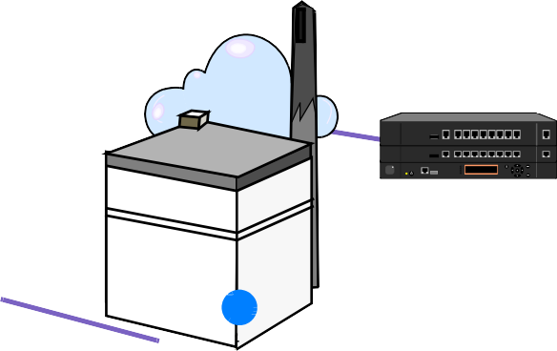




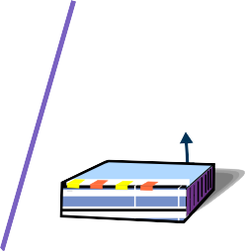







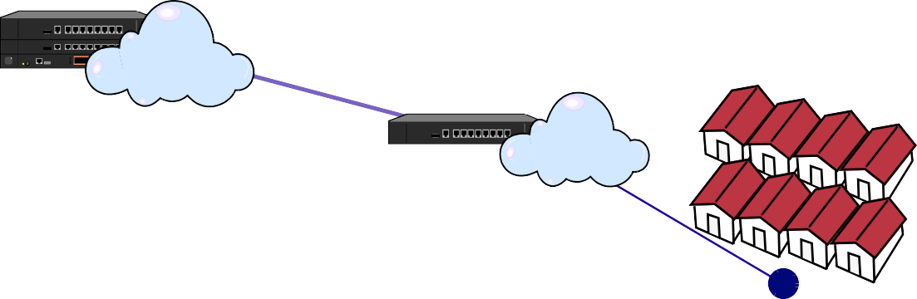










The new Smart Power Grid
Customers
© 2020 ALBEDO Telecom - All rights reserved
VoIP
PTP
Generation
C-Ethernet MPLS-TP
E1-T1
Distribution
Internet
GOOSE
Datacom
SV
GOOSE
Customers
C-Ethernet
Transmission
Substation
MMS
Data Network
Measuring and Control points
Distribution
Substation
Smart Grid require a Telecom Data Network to communicate all the elements of the Power System, including Generation plants, Substations and Customers in order to increase the efficiency, resilience and quality of the power grid, while allowing advanced management.
Timing Convergence refers to the adoption of Ethernet-based protocols such as PTP and NTP to satisfy the demand of Synchronization in an available, accurate, reliable and standard way.

Slide 3




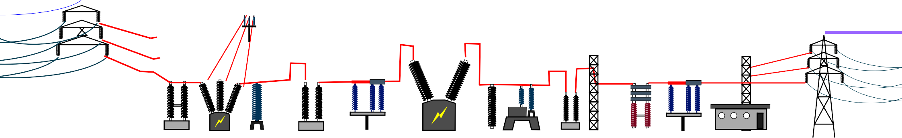



The IEC 61850 in the Substation
Time Critical
Time Sensitive
Substations are the building blocks of the grid.
Automation refers to the massive use of data and communications to assure the stability, efficiency and integrity of the power Service.
IEC-61850 facilitates the automation and interoperability of intelligent devices by means of standard protocols to configure, control, synchronize, transmit data, measure, and protect the grid.
Applications
Time Sync
Control
SV
GOOSE
PTP
SNTP
MMS
UDP
TCP
IP
PRP-HSR (fault-tolerant)
Ethernet
I E C - 6 1 8 5 0
©

Slide 4












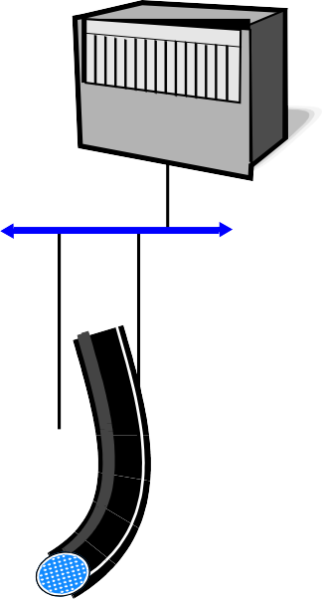



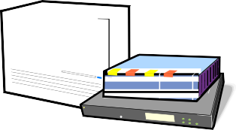
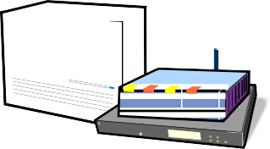










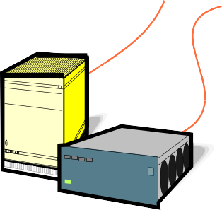









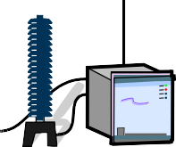
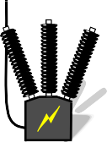

0 - Substation Evolution
S U B S T A T I O N - 1
Legacy
S U B S T A T I O N - 2
Conventional
S U B S T A T I O N - 3
Digital
S U B S T A T I O N - 4
Smart Grid
GNSS SCADA
© 2020 ALBEDO Telecom - All rights reserved
SCADA
Datacomms
SCADA
MMI, Control Board
PTP Master
VoIP
Internet
HMI
SONET
GNSS
SONET
GNSS
ALBEDO
Station
Ethernet
MPLS-TP
E1-T1
C37.94
E1-T1
C37.94
Station clock
NTP clock
Copper
Proprietary Bus
Gateway
SNTP, PTP
SNTP
Gateway
Control
Control
Events Recording
F.O.
Station Bus IEC 61850-8-1
Station Bus IEC 61850-8-1
GOOSE, MMS
F.O.
Bay
Timing
Timing
F.O.
LAN A
LAN B
SNTP
PRP
PTPoPRP
Hardwired Protection Relay
IRIG-B
IRIG-B
Relay
Protection Relays
IED
IED
Process
Copper
PTP
Copper
Copper
Process Bus IEC 61850-8-2
SV
GOOSE
F.O.
VT CT
Metering
Switch Gear
VT CT
Metering
Switch Gear
VT CT
Metering
Switch Gear
VT CT
MU
CB

Slide 5




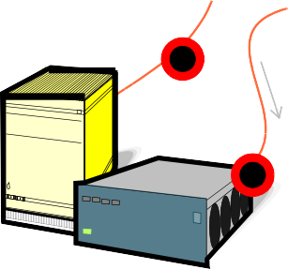
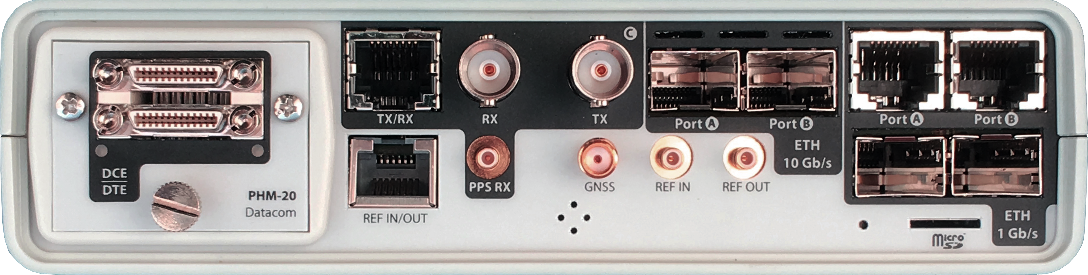


1-2 – Test in Legacy-Conventional substations
SCADA
Datacomms
What to Test
Serial communication data: RS-232, RS-422, V.35, V.36
IRIG-B: timing
E1 / T1: pulse, voice, data
C37.94: one-way / two-way delays, event emulations
Teleprotection: One-way delay
Ethernet capacity/quality: RFC 2544, eSAM, etc.
Station
HMI
SONET
E1-T1
C37.94
Proprietary Bus
Control
Events Recording
Bay
Objectives
Check and adjust teleprotection based on C37.94
Check the quality of the Ethernet network
Timing
Protection Relays
IRIG-B
PHM
RJ45-C
BNC-C
SFP+ A
SFP+ B
RJ45-A
RJ45-B
Process
Copper
RJ45
SMB-C
SMA
SMB-1
SMB-2
SFP-A
Micro SD
SFP-B
Testing
Points
xGenius testing interfaces
VT CT
Metering
Switch Gear

Slide 6









3 – Test in Digital Substations
SCADA
GNSS
Ethernet
SONET
What to Test
Serial communication data: RS-232, RS-422, V.35, V.36
IRIG-B: timing
E1 / T1: pulse, voice, data
Ethernet: RFC 2544, eSAM, etc.
IP: ping, trace route
Fiber Optic: Power, OTDR
NTP: message, delays, jitter, TE
Teleprotection: C37.94, One-way delay, Quality
Station
E1-T1
C37.94
NTP clock
SNTP
Gateway
F.O.
Station Bus IEC 61850-8-1
Bay
F.O.
SNTP
Objectives
Check the teleprotection times C37.94
Check and adjust IRIG-B and NTP synchronisms
Check the quality of the Ethernet network
Install and maintain fiber optics
Relay
IED
Process
Copper
Testing
Points
PTP/NTP clock
VT CT
Metering
Switch Gear

Slide 7


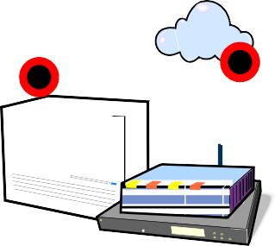




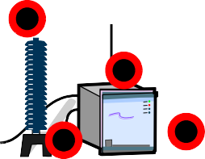
4 – Test in IEC-61850 Substations
PTP Master
What to Test
Serial communication data: RS-232, RS-422, V.35, V.36
IRIG-B: time
E1 / T1: pulse, voice, data
C37.94: delays, event emulations
Teleprotection: Unilateral delay
Ethernet: RFC 2544, eSAM, etc.
IP: ping, tracking route
MPLS-TP
Fiber Optic: Power, OTDR
NTP: message, delays, jitter, TE
PTP: Wander, PPS, TE
GOOSE: analysis / capture / decoding
SV: analysis / capture / decoding
MMS: analysis / capture / decoding
Master / slave clock emulation
IEC-61850: delay of protocols
Objectives
Guarantee the interconnection between different manufacturers
Interconnection of new and old PTP-NTP-IRIG-B synchronism
Install and develop new protocols like GOOSE
Station
VoIP
Internet
¹.......^{p}....^{p}....^{s / TOD} 17:23UTC
GNSS
ALBEDO
Ethernet
MPLS-TP
Station clock
SNTP, PTP
Gateway
Station Bus IEC 61850-8-1
Bay
F.O.
GOOSE, MMS
LAN A
LAN B
PRP
PTPoPRP
IED
Process
PTP
Process Bus IEC 61850-8-2
SV
GOOSE
F.O.
Testing
Points
MU
CB

Slide 8
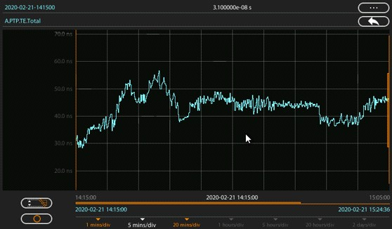
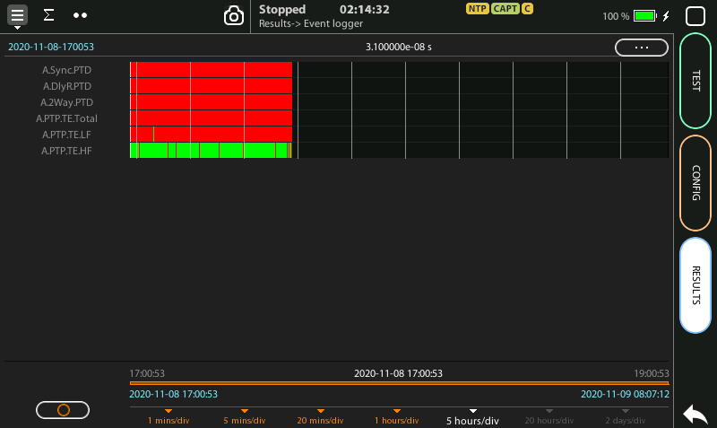
PTP Timing Analysis
TE chronograph
© 2020 ALBEDO Telecom - All rights reserved
Objectives
Acceptance (IEDs, TCs, GMs, SCs…)
Bringing into service
Maintenance and troubleshooting
Performance monitoring
Tests
Performance in locked mode
Reference switchover test
Holdover performance
Interoperability with Power / Utility profiles
TC testing
Performance Metrics
TE or TIE
Frequency offset and drift
Delay and delay asymmetry
TE analysis (PASS/FAIL)

Slide 9

PTP testing in Power Utility Applications
© 2021 ALBEDO Telecom - All rights reserved
Three different PTP Profiles
IEEE C37.238 (2011), “Power profile”
IEEE C37.238 (2017), “Power profile”
ISO/IEC 61850-9-3, “Utility profile”
Some particularities
Peer-to-peer delay mechanism
Paralel Redundancy Protocol (PRP)
“Special” TLVs: ATOI, C37.238 extension
PTP Telecom profiles and NTP used very often
PTP GM
¹.......^{p}....^{p}....^{s / TOD} 17:23UTC
PRP
LAN A
LAN B
IED (PTP SC)
Peer Delay Request / Response
Peer Delay Request / Response
Peer Delay Request / Response
IED (PTP SC)
PTP GM
TC
TC

Slide 10
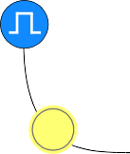





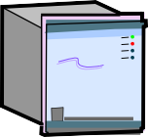


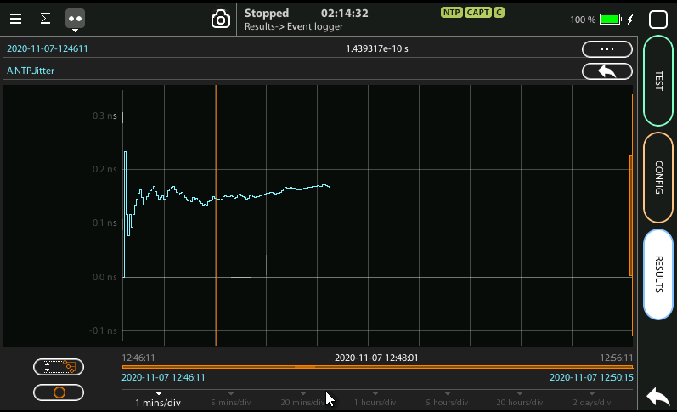



NTP testing
Offset: difference between clocks
Stratum 2, 3
IP
Offset = 5’
Client
NTP Server
Stratum 1
IP
NTP Server
Client
Objectives
The same that for PTP
Stratum 2, 3
Stratum 1
Testing features
NTPv3 / v4 server and client emulation
Traffic filtering, classification, analysis
NTP delay and asymmetry
Statistics of Time Error (TE)
IP
NTP Server
Client

Slide 11
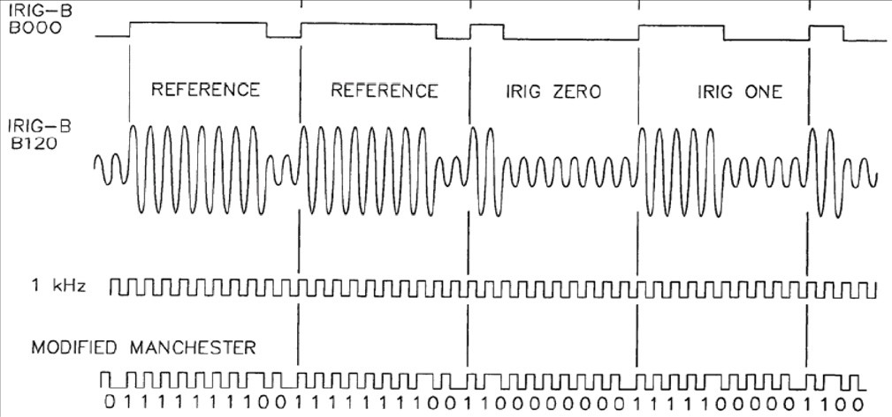
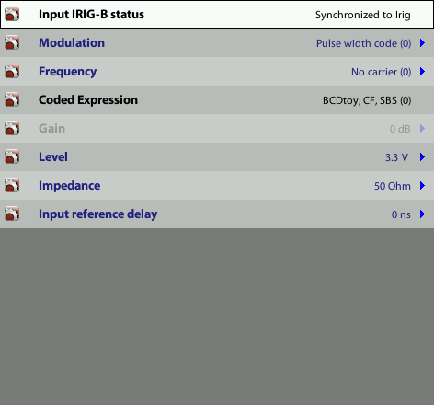

IRIG-B testing
IRIG - Xabc
0: BCD, CF, SBS
1: BCD, CF
2: BCD
3: BCD, SBS
4, 5, 6, 7: others
0: No carrier (DCLS) 1: 100 Hz
2: 1 kHz
3: 10 kHz
4: 100 kHz
5: 1 MHz
0: Unmodulated DCLS
BCD 0000 = 0
0001 = 1
0010 = 2
0011 = 3
0100 = 4
0101 = 5
0110 = 6
0111 = 7
1000 = 8
1001 = 9
BCD - Binary Coded Decimal, coding of time (HH,MM,SS,DDD) SBS - Straight Binary Second of day (0....86400)
CF - Control Functions depending on the user application
© 2020 ALBEDO Telecom - All rights reserved
Rate
Coding
A: 1000 PPS
> IRIG-B: 100 PPS <
D: 1 PPM
E: 10 PPS
G: 10000 PPS
H: 1 PPS
IRIG SAMPLES: B000, B120, B220
Carrier
DCLS B000
AM B120
Modulation
1: AM (Amplitude Modulated)
2: Manchester Modulated
MANCHESTER B220
IRIG-B sends a timing signal every second at 100 pulse/sec rate therefore the 100 is the number of bits of each frame. IRIG-B info includes Year, Day, Hour, Min, Sec.
AM modulated clock reference input and output
Unmodulated (DCLS) i/o over RS-422 / RS-485 or TTL
Manchester encoded IRIG-B input and output
Test & Measurement
Analysis of the received IRIG-B frame
Events: Leap seconds, Time Zones, DST…
Timing accuracy: Timestamp decoding, Time Scale, Time Error
IRIG-B

Slide 12
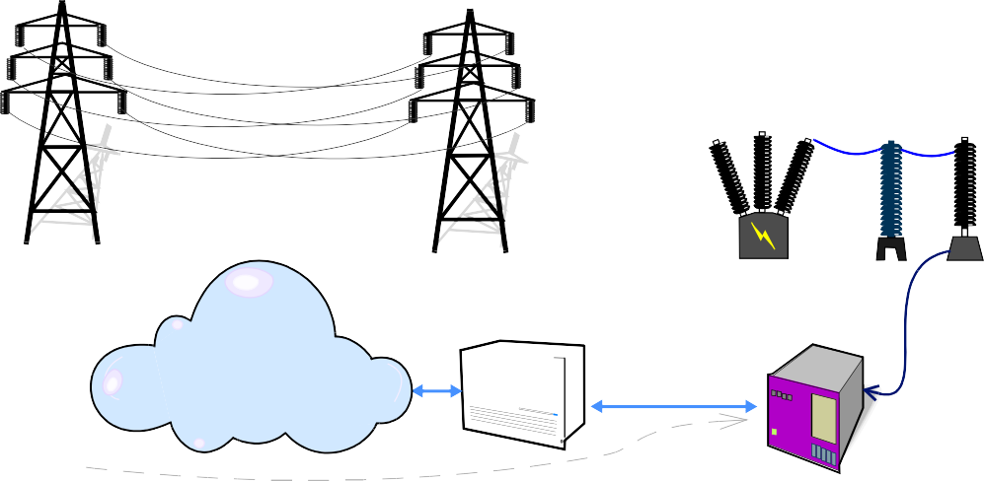
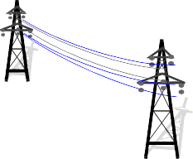
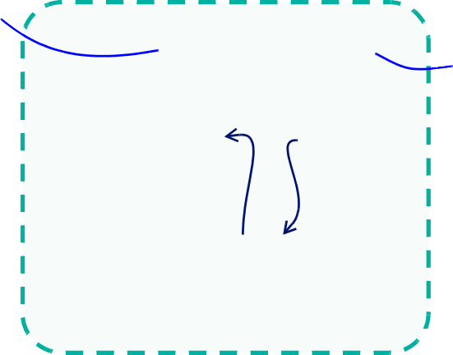
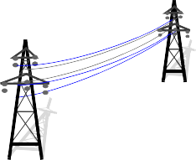

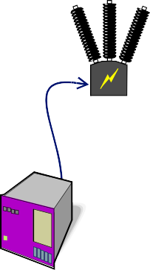




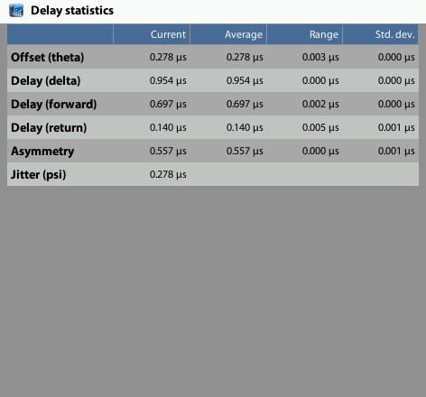
Delay and Asymmetry assurance
© 2020 ALBEDO Telecom - All rights reserved
S U B S T A T I O N - 1
S U B S T A T I O N - 2
IED
Latency < 2 ms Latency < 10ms Latency < 2 ms
Testing Delay Modes
Bidirectional Delay (Round-Trip Delay)
One way delay with GNSS or ToD help Latency results
Bidirectional Delay or Round-Trip Delay (RTD)
One Way Delay Forward and Reverse Path
Asymmetry with min. / max records
Patch cord delay compensation
PASS / FAIL indication
Objectives
Bidirectional Delay or Round-Trip Delay (RTD)

Slide 13




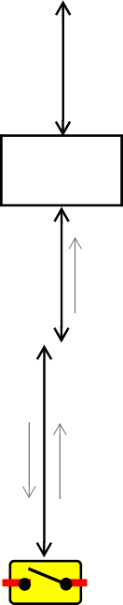
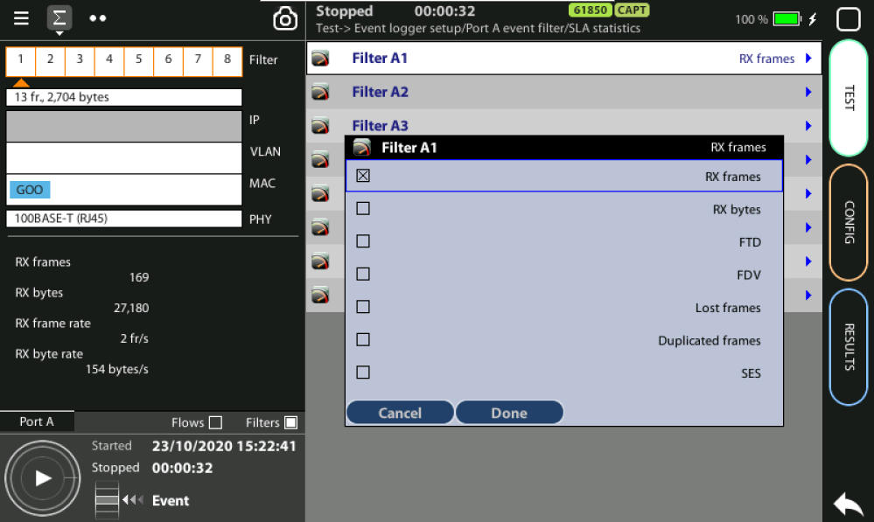
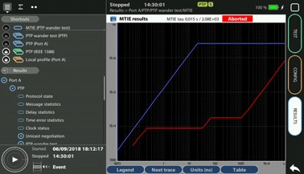
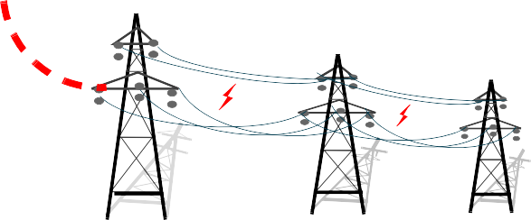
Capture & Analysis of GOOSE packets
Station
GOOSE is a messaging system used by IEDs and mission-critical applications to report substation events: commands, alarms, indications, measurements
Station Bus IEC 61850-8-1
Bay
IED-1
Measures
IED-2
Protection
IED-3
Control
GOOSE-2
SV GOOSE-2
GOOSE-1
GOOSE-2
Process
SV
MU
GOOSE-1
GOOSE-2
VT CT
CB
Primary Power
Objectives
Decoding of faults in GOOSE protocol
Facilitate interconnection between manufacturers
Verify and adjust the latency of GOOSE packets

