Slide 2
Multi-Vendor PTP Monitoring
Thomas Gunkel
Global Market Director Broadcast
Skyline Communications

Slide 3

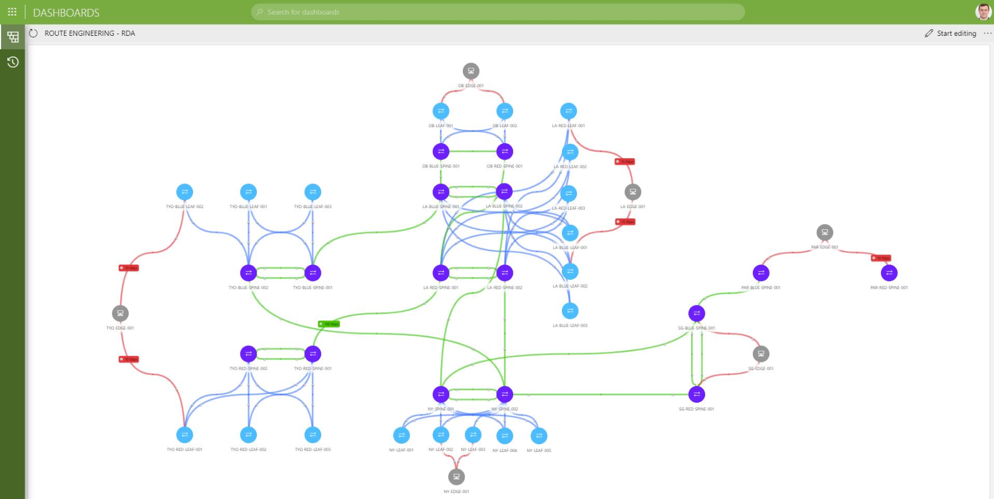
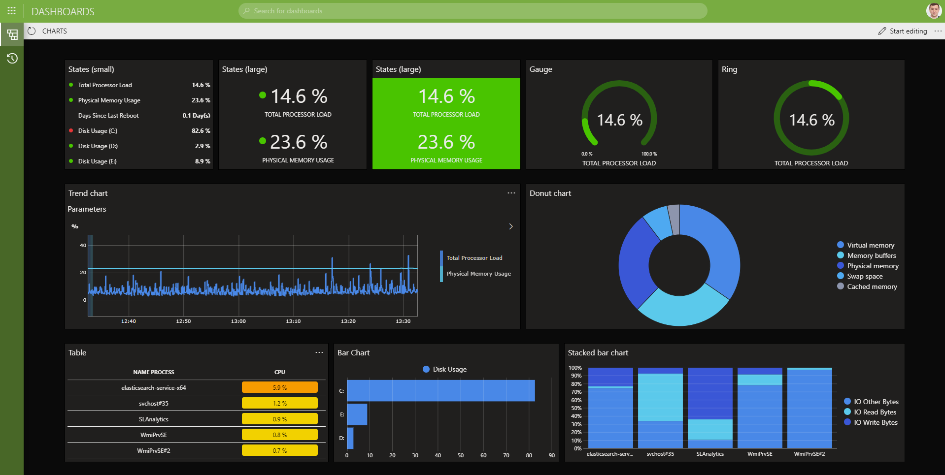
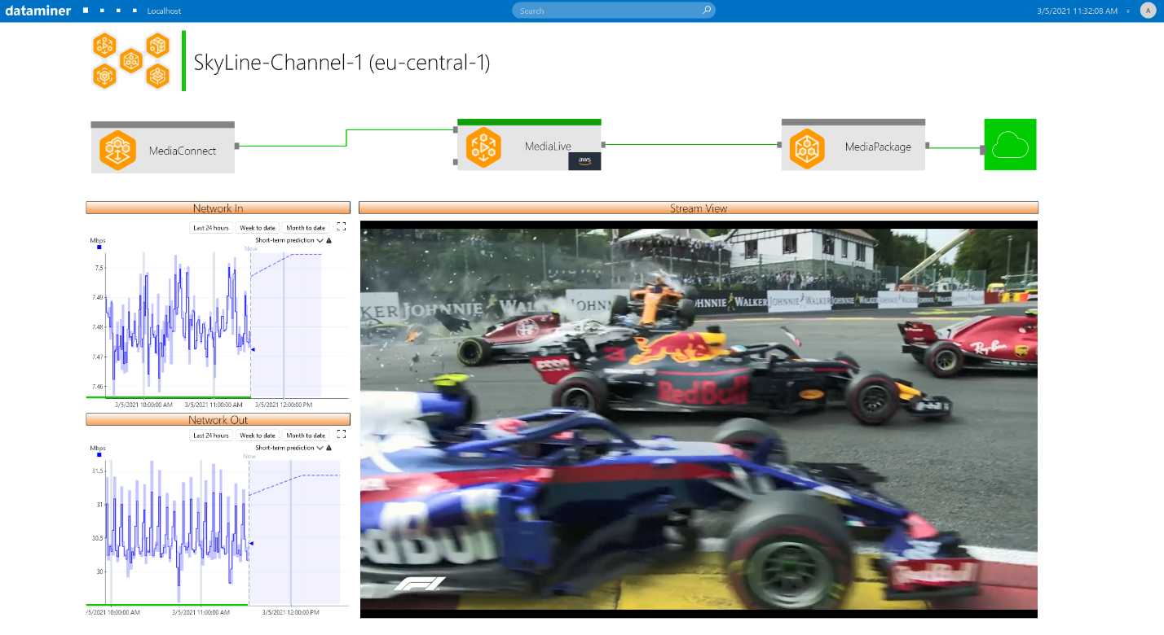
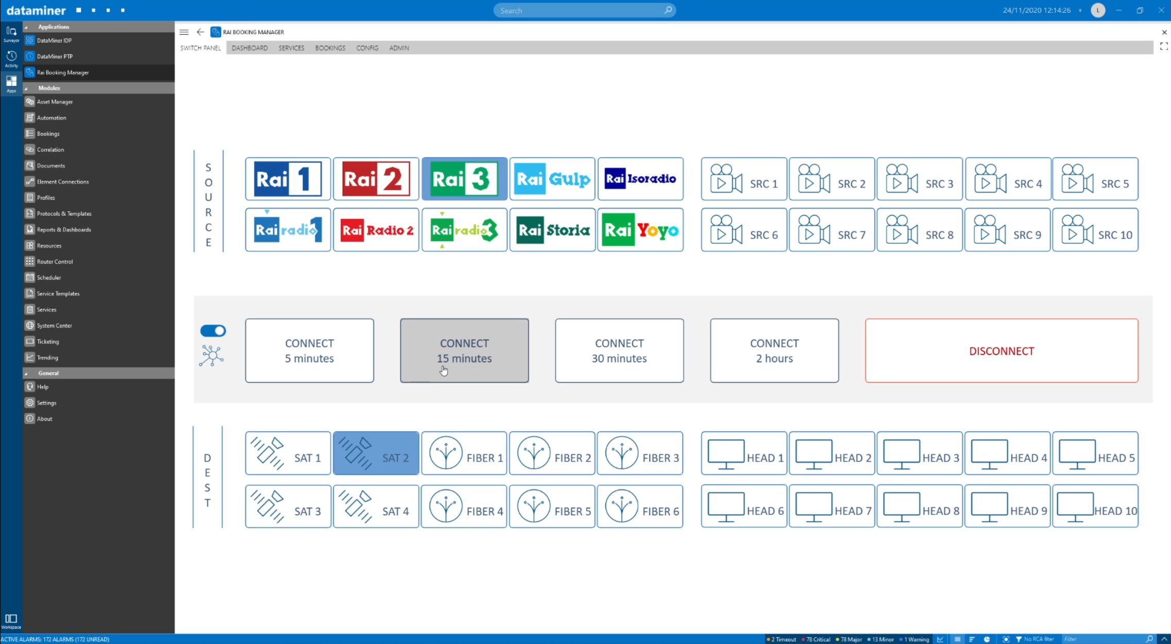
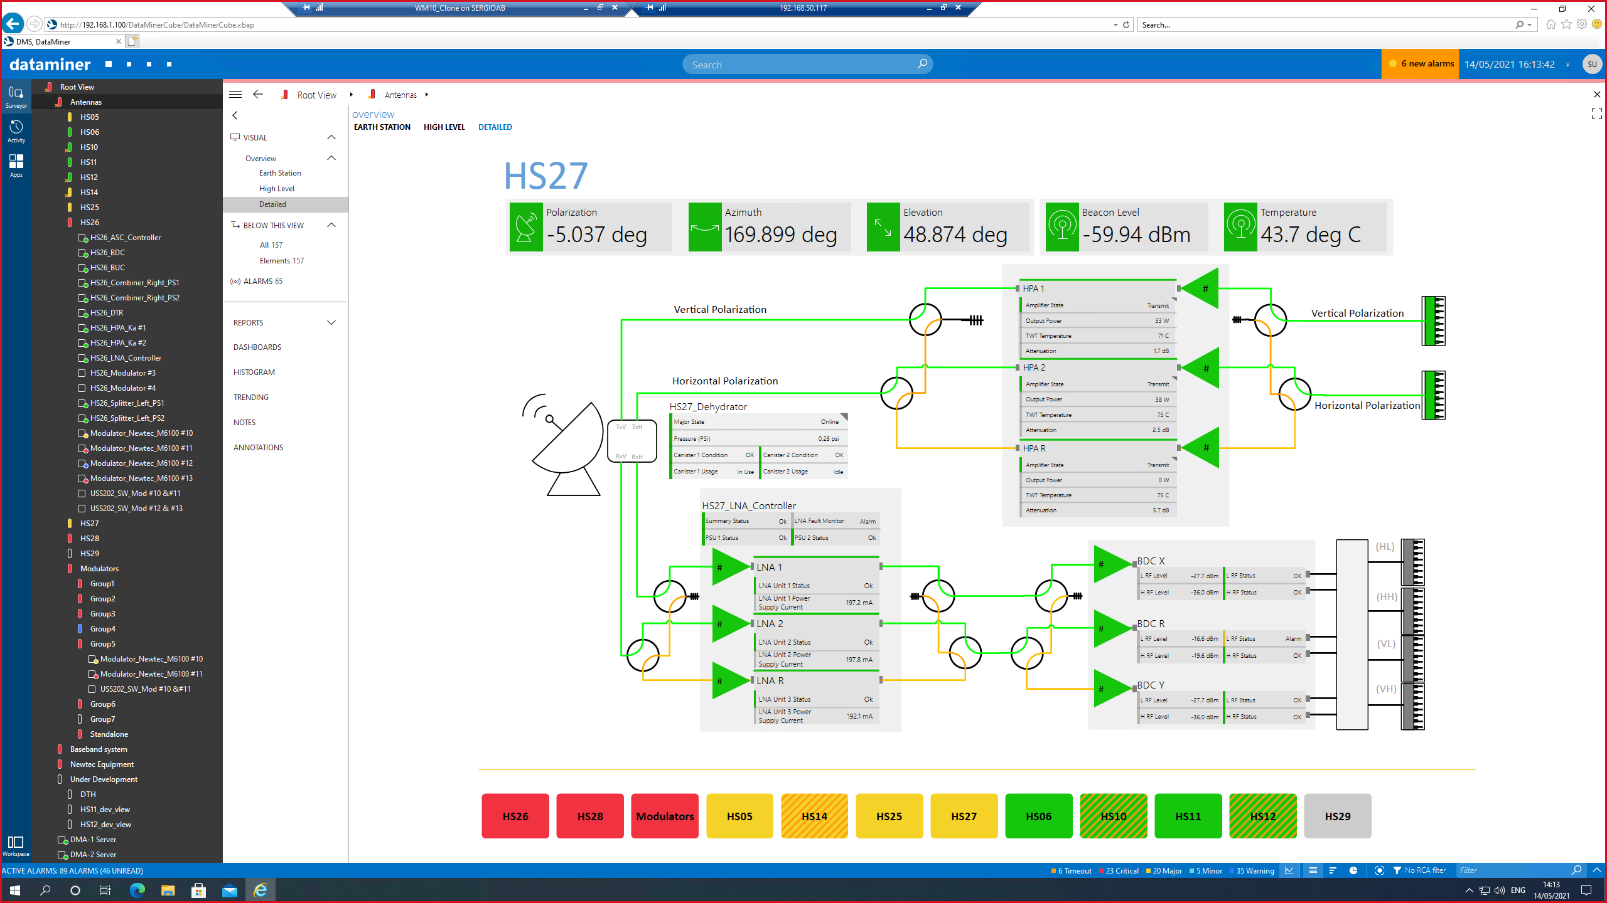
End-to-end open monitoring and orchestration software for ICT media and broadband platforms
Multi-Vendor PTP Monitoring
1500+ users across 120 countries
> many of them use PTP
10.000+ dataminer nodes deployed
7.000+ product integrations
1000+ different vendors
Thomas Gunkel
Global Market Director Broadcast – Skyline Communications
350+ people
local presence in 20 countries
ICT, software, cloud, media & broadband experts
Notes:
Pitch: cannot afford any issue with PTP – impact is huge!
Loss of signal……
Meet and exceed what an enterprise needs…..
Extremely critical areas – top notch – high demanding applications

Slide 4
WHY
PTP MONITORING ?

Slide 5




Why PTP Monitoring?
PTP is a mission critical service things can and do go wrong
bad foundation (design & configuration)
network design: no routed network, non PTP-aware switches, mix of PTPV1 and PTPV2, devices locked to different time, …
PTP configuration: PTP parameters, BMCA settings, messaging rate intervals, communication mode
PTP node issues
grandmaster, boundary clock failure
loss of external reference (GNSS)
implementation bugs: BMCA or PTP master election process
network issues
missing or corrupted PTP event messages
increased packet delay variations (PDV) – especially on WAN
network asymmetry between receive and transmit path (link speed conversion)
network path re-arrangement
multicast issues
Notes:
PTP parameters & BMCA settings (domain, priority1, priority2, profiles, delay mechanism, etc.)
messaging rate intervals (announce message, announce timeout, sync message, delay request, delay response, etc.)
communication mode (unicast, multicast, mixed)

Slide 6
before you start:
PTP Provisioning

Slide 7
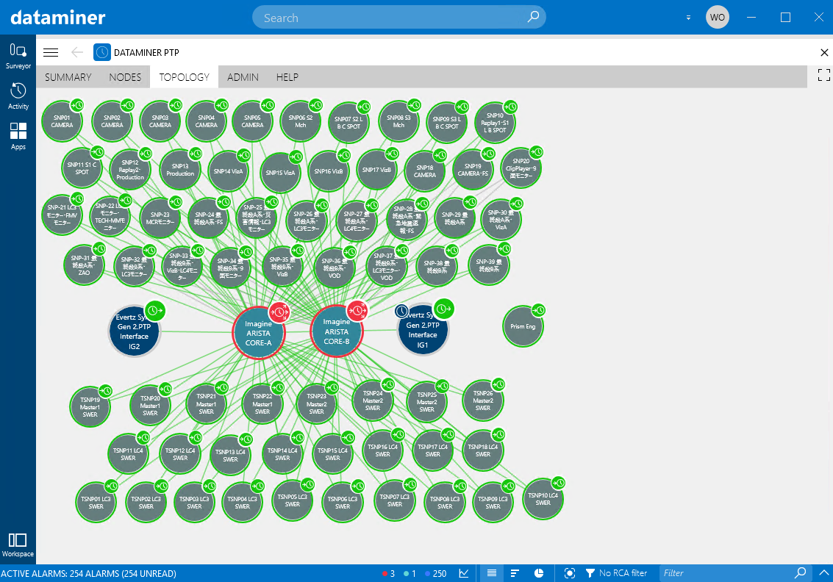
PTP Provisioning
still is a challenge
detect any new PTP-aware device (IS-04 / proprietary protocols)
extract network / PTP topology (LLDP)
apply standard PTP settings/profiles to ANY grandmaster, switch, follower device
compare PTP configurations
define and apply “golden” configurations
apply PTP security workflows
hundreds of devices and thousands of parameters need to be configured
AUTOMATION
Notes:
apply PTP security workflows (e.g. block PTP slave devices to never become a master)

Slide 8

PTP provisioning in practice
PTP profiles
pick the right PTP profile for your application
(automatically) configure every single PTP node
including every interface of your boundary clocks
Example (ST 2059-2:2021) | Range | Default Value
Announce Interval | -3 to 1 | 0
Announce Timeout Interval | 2 to 10 | 3
Sync Interval | -7 to -1 | -3
Delay Request Interval | Sync to Sync +5 | Sync
Domain | 0 to 127 | 127
Priority 1 | 0 to 255 | 128
Priority 2 | 0 to 255 | 128

Slide 9
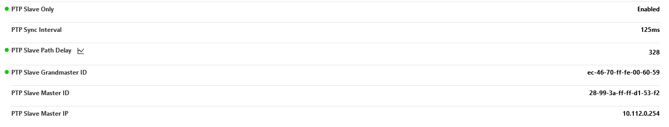
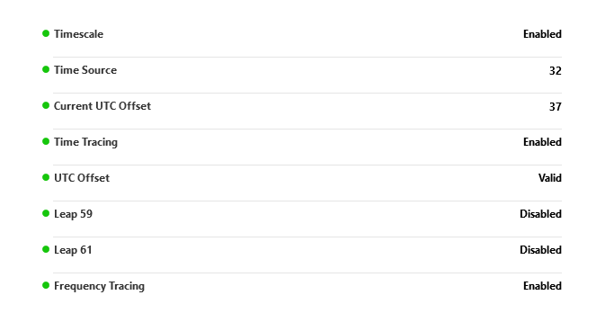
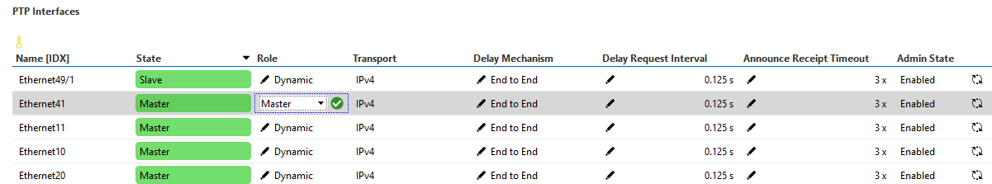
PTP provisioning in practice
apply PTP security
use a traceable PTP clock source
monitor the frequency-traceable and time-source-traceable flags
use the “slave only” feature
prevent PTP slaves becoming a grandmaster
p
only allow “preferred” & “potential” grandmasters
use the acceptable master table (AMT) to create a whitelist of PTP nodes that can become a grandmaster
use “PTP Role = Master”
boundary clock feature to discard PTP announcement messages from misconfigured PTP followers

Slide 10
PTP MONITORING

Slide 11

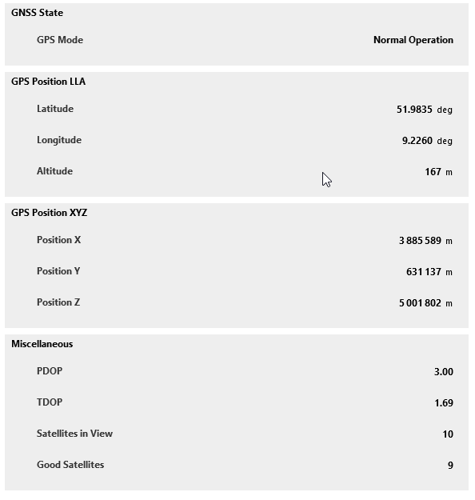
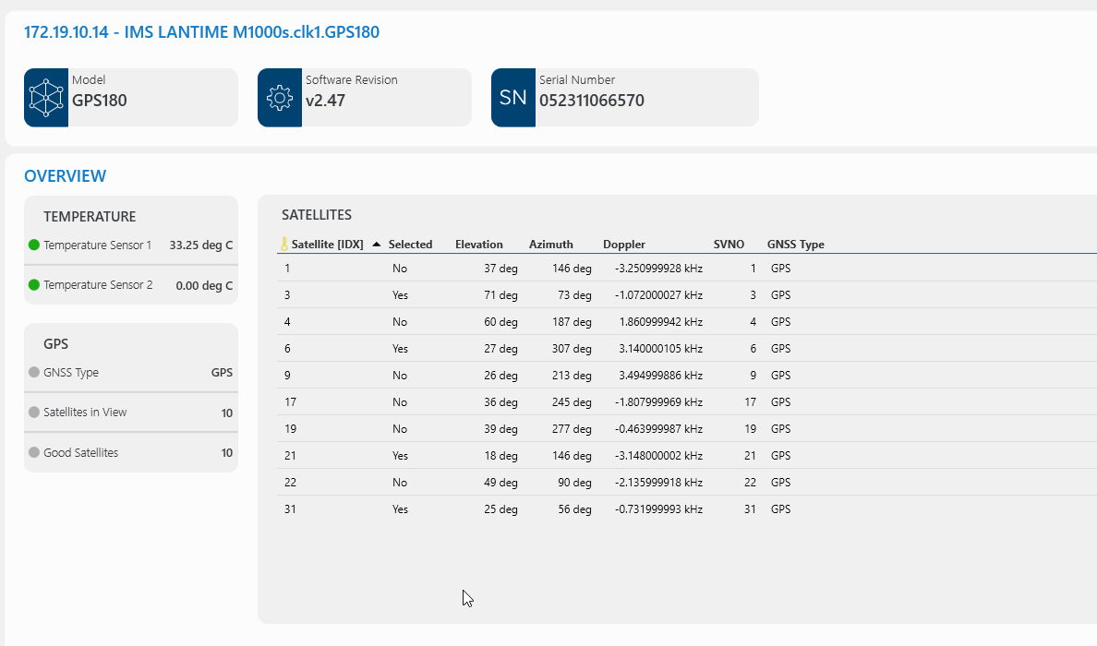
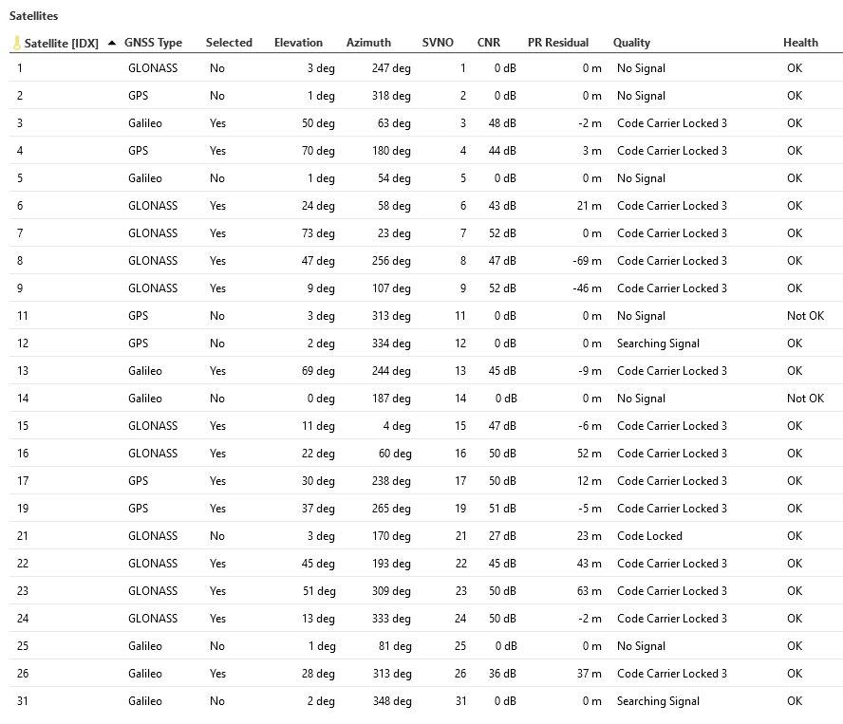
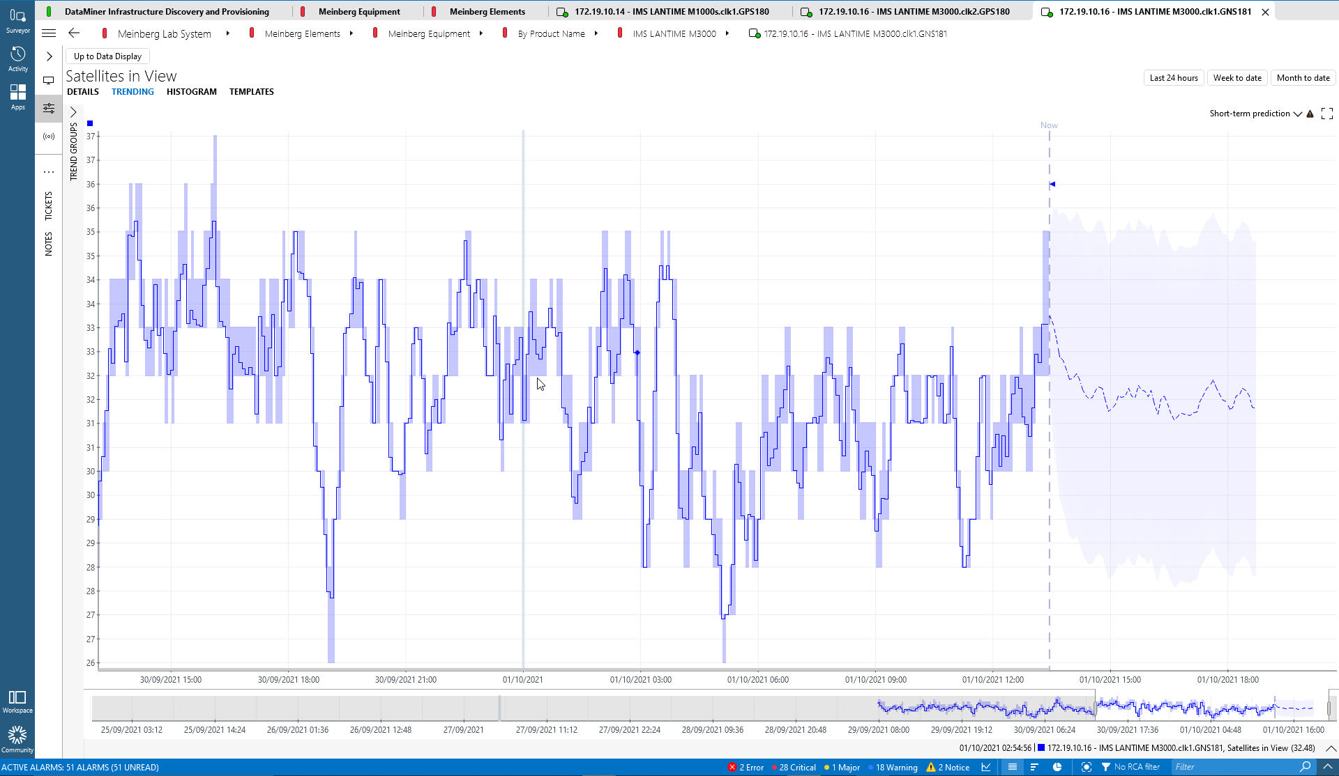
PTP in practice – monitoring
know your GNSS
use a clock source with GPS spamming and spoofing detection and protection mechanisms
satellites in view
signal strength
carrier to noise ratio
latitude, longitude, altitude
oscillator status
reference clock

Slide 12
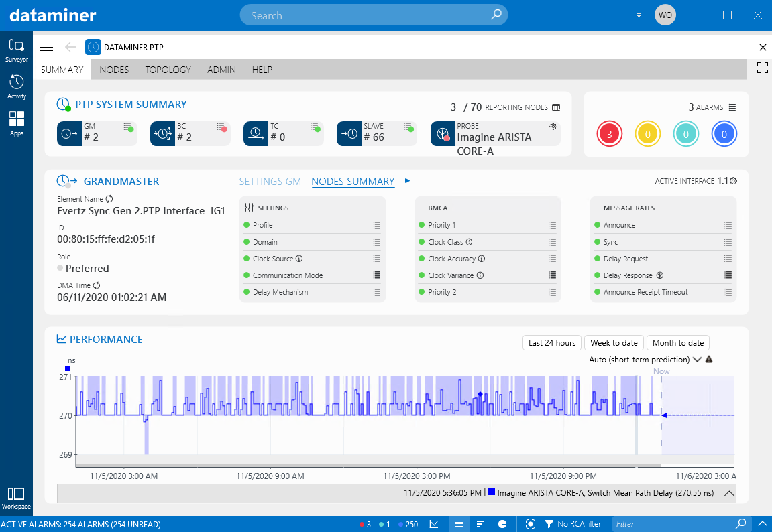
PTP in practice – monitoring
PTP is not a static system - BMCA is constantly running
monitor your PTP clock source
monitor every single PTP metric on all PTP grandmasters, PTP leaders, PTP followers
monitor PTP performance (PTP offset, PTP mean path delay, …)
monitor PTP multicast messages (network packets as well as switch tables)
integrate probes, PTP & network analyzers (compare configuration versus real situation in the network)

Slide 13
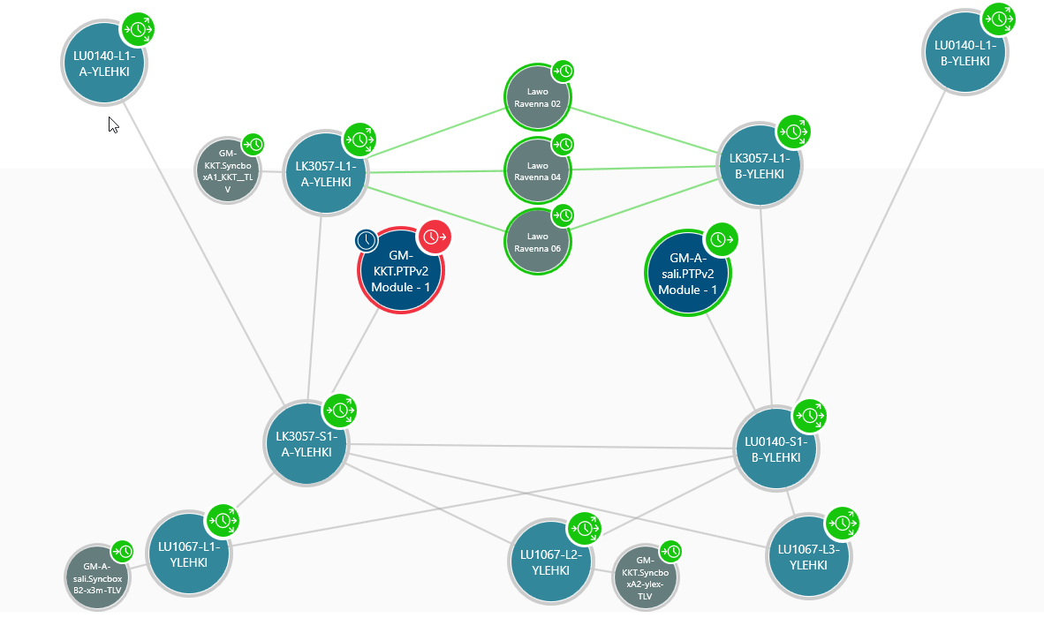
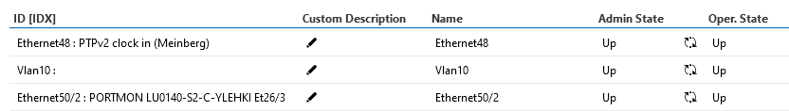
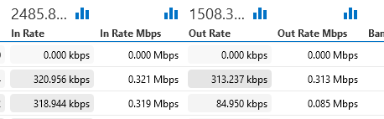
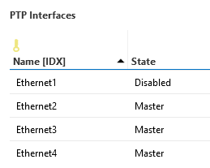
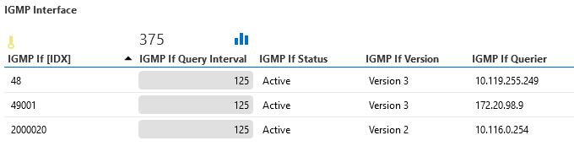
PTP in practice – monitoring
know your network
know your physical and logical topology
check if PTP has been enabled on each interface
monitor the interface admin and operational status
monitor interface In & Out rates
check your multicast settings

Slide 14
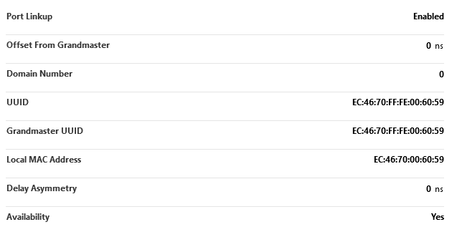
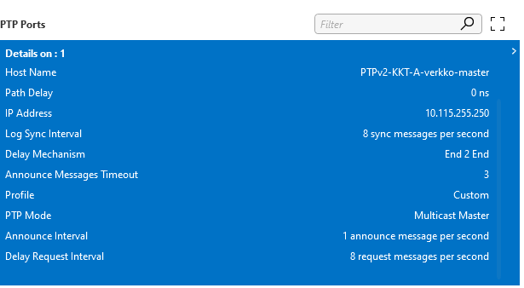
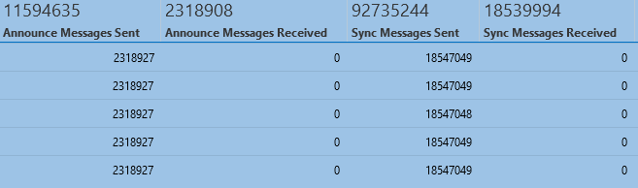
PTP in practice – monitoring
monitor against your PTP profile
monitor PTP domain on each node
make sure you have consistent messaging rates across all nodes
monitor device configuration / settings
AND monitor the actual packets in the network (boundary clocks, analyzers, …)

Slide 15
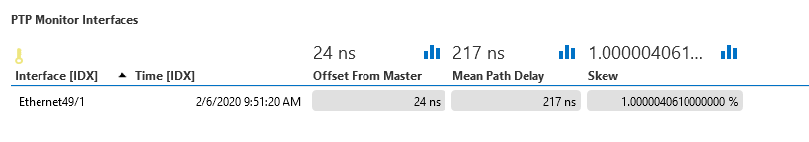
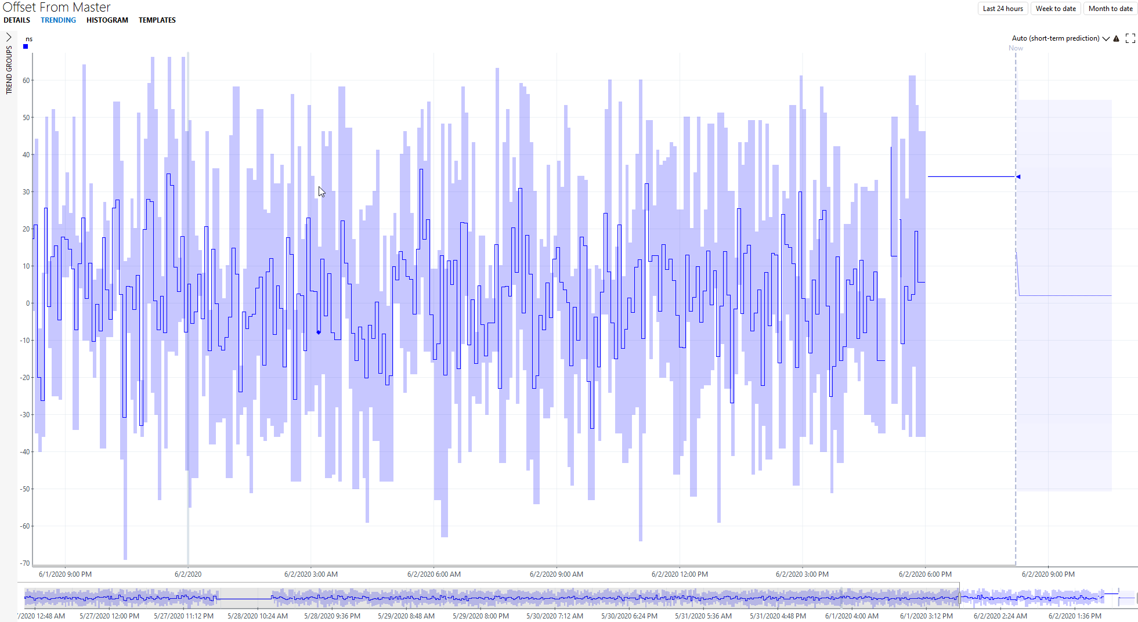
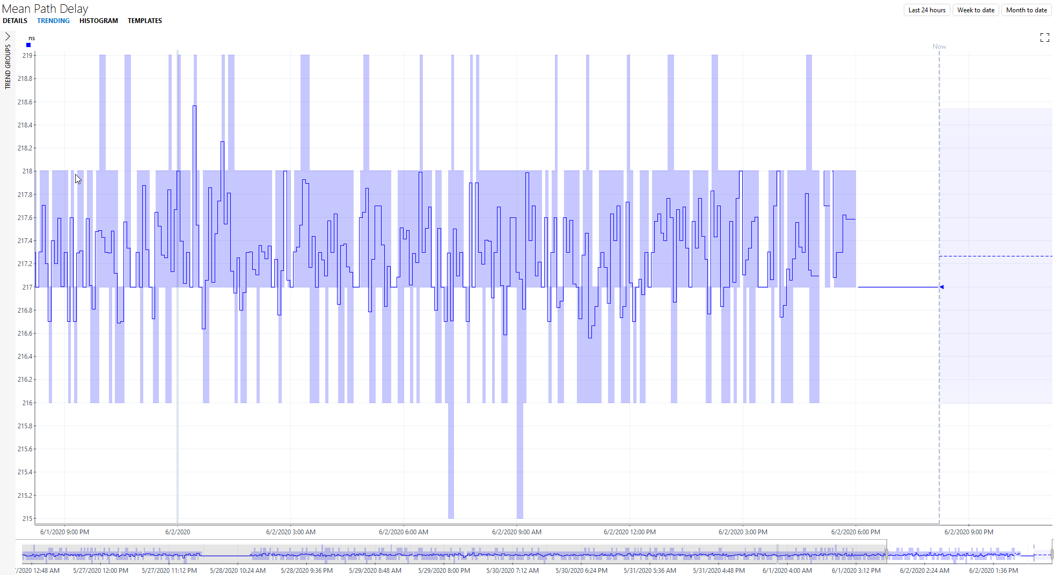

PTP in practice – monitoring
monitor PTP performance over time
offset from master
mean path delay
leader to follower delay
follower to leader delay

Slide 16
PTP
The Multi-Vendor Challenge

Slide 17


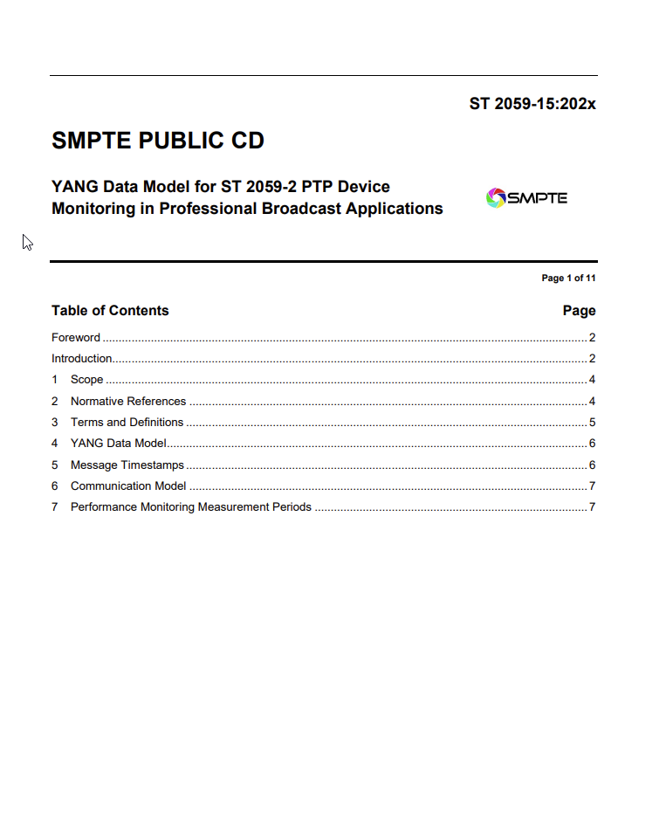
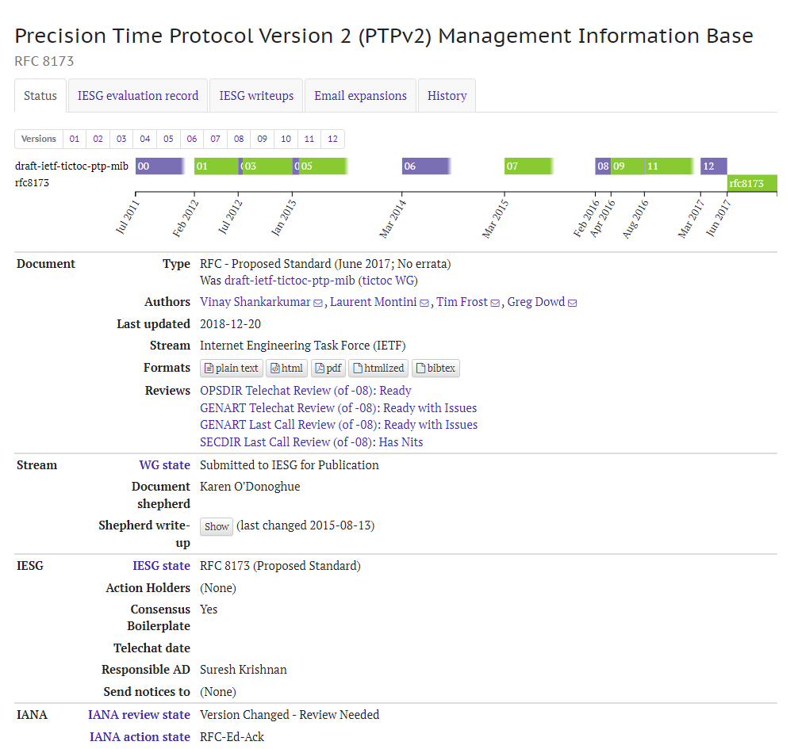
PTP in multi-vendor environments - the challenge
360° E2E PTP monitoring is multi-vendor by nature
inconsistent &
difficult to monitor
standards and recommendations are available
vendors implement PTP in different ways
different APIs & interfaces
different set of supported parameters
different names, values, units, intervals

Slide 18
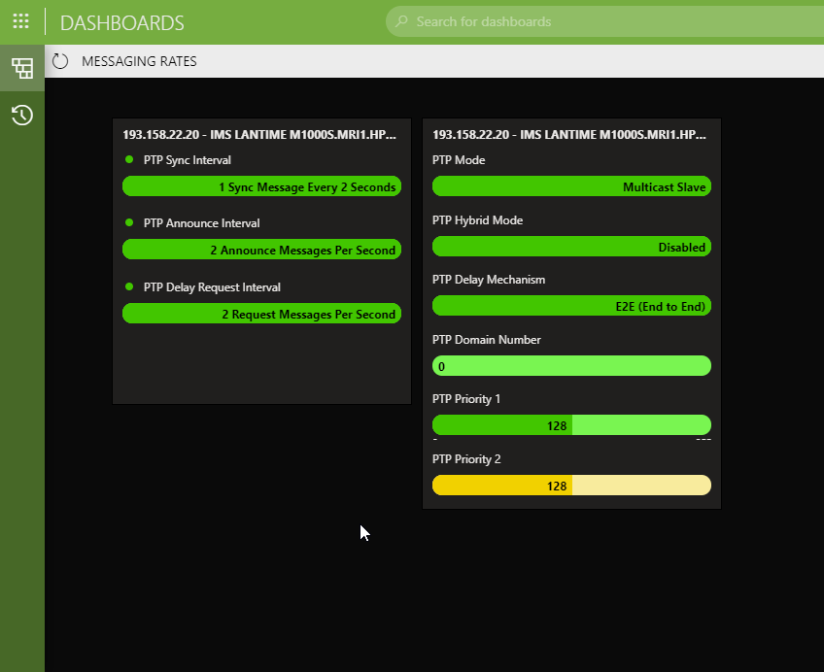


PTP in multi-vendor environments - example
Parameter: PTP Announcement Message Interval
PTP Profile
logAnnounceInterval
-2 (log base 2)
vendor
implementation
NMS
mediation layer
Vendor A: announce: 0,25
Vendor B: annoucement messages: -2
Vendor C: announce interval: 1/4s
Vendor D: announcement interval: 4 per sec
Vendor E: announce interval: 4
data
visualization
identical parameters
& easy-to-read
data consolidation

Slide 19
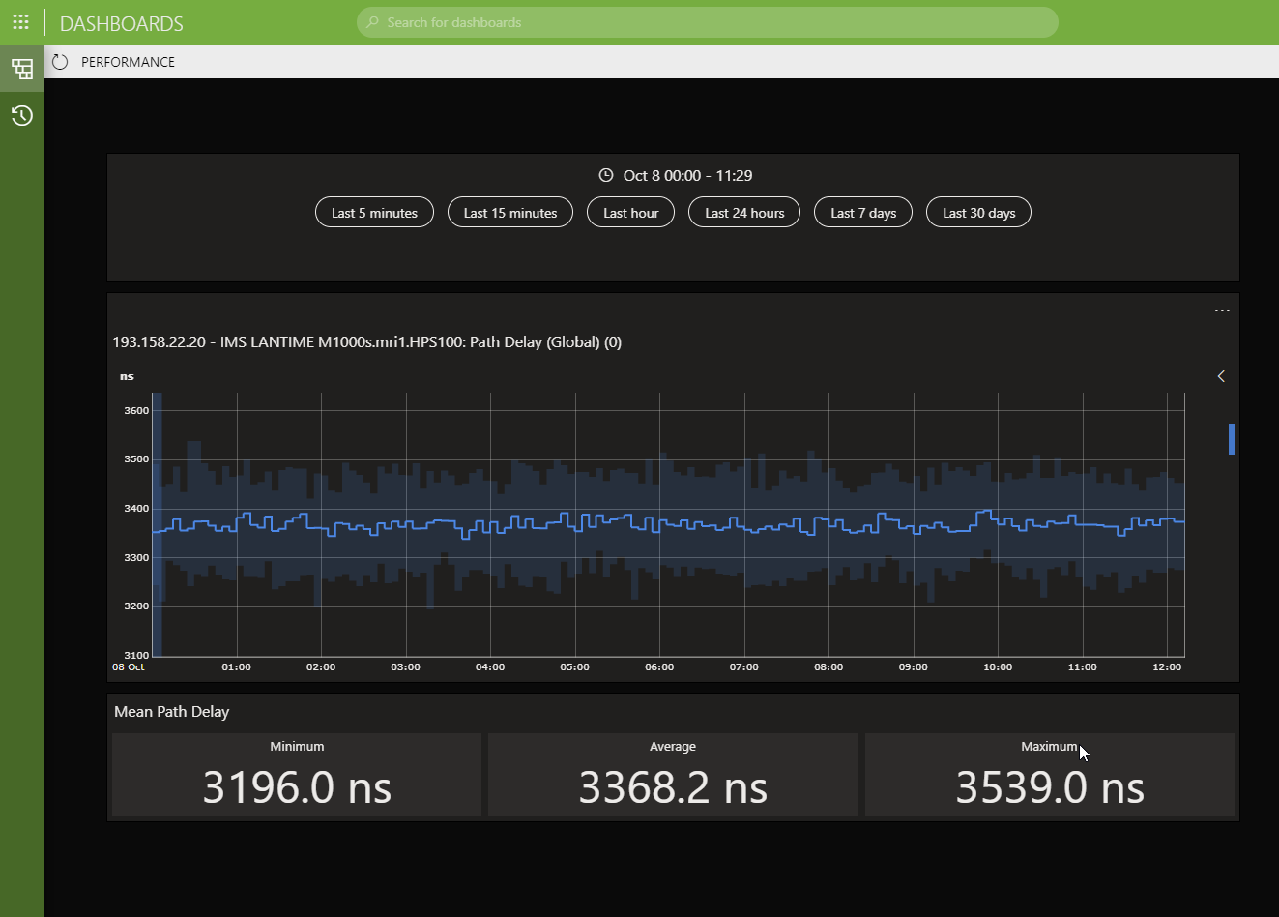
PTP in multi-vendor environments - example
Performance Monitoring
PTP YANG data model
average
minimum
maximum
standard deviation
use UTC
align with quarter of an hour
24h starts at midnight
every 15 min for 24h
previous and current 24 h interval
NMS
protocol engine
vendor performance data
any interface
any protocol
polling
data
processing,
aggregration &
storage
data
visualization
eventing
Notes:
98 values in total

Slide 20


SUMMARY
every PTP system is multi-vendor by nature
mediate (streamline) your data (PTP metrics and values)
automate PTP provisioning as much as possible
monitor PTP parameters on every PTP node
monitor PTP network traffic
track PTP performance
detect PTP (config & BMCA) changes

Slide 21
Thomas Gunkel
Global Market Director Broadcast
thomas.gunkel@skyline.be

