Slide 1
PTP at Facebook
Oleg Obleukhov
Production engineer
Notes:
My name is Oleg…. PE
Today we are gonna talk about improving time accuracy of servers Across the Facebook Fleet

Slide 2
Last year:
Improving Time Accuracy of Servers Across the Facebook Fleet
Oleg Obleukhov
Production engineer

Slide 3
Last year. NTP precision

Slide 4
Improve?

Slide 5
Catch 22
Improve time precision?
Do we have a use case for precise time?
Do we have a precise time infra?
Yes
No
Yes
Let’s do that!
Notes:
Improve precision -> need infra No infra? Need usecase!
Here we enter our Catch22.
No use case? No infra. No Infra – No use case.

Slide 6
Use case

Slide 7
Linearizability
a.k.a.
External consistency
Notes:
A very common use case in DC
Strong correctness guarantee which ensures we always read the latest data
In practice it can be achieved using 2 technics. Commit-wait or Quorum reads. Let go through both.

Slide 8
Linearizability. Commit - Wait
Commit
Sleep N
Read
Notes:
As simple as sounds.
The duration of sleep depends on many things, including the clocks uncertainty.

Slide 9
Linearizability. Quorum reads
Commit
Read
(Quorum 3 out of 5 must have the data)
Notes:
Quorum read is a lot more complicated for users, but does not require any sleep.
From obvious disadvantages – we need to wait for several nodes.
It will probably makes sense if the network latency is very small.

Slide 10
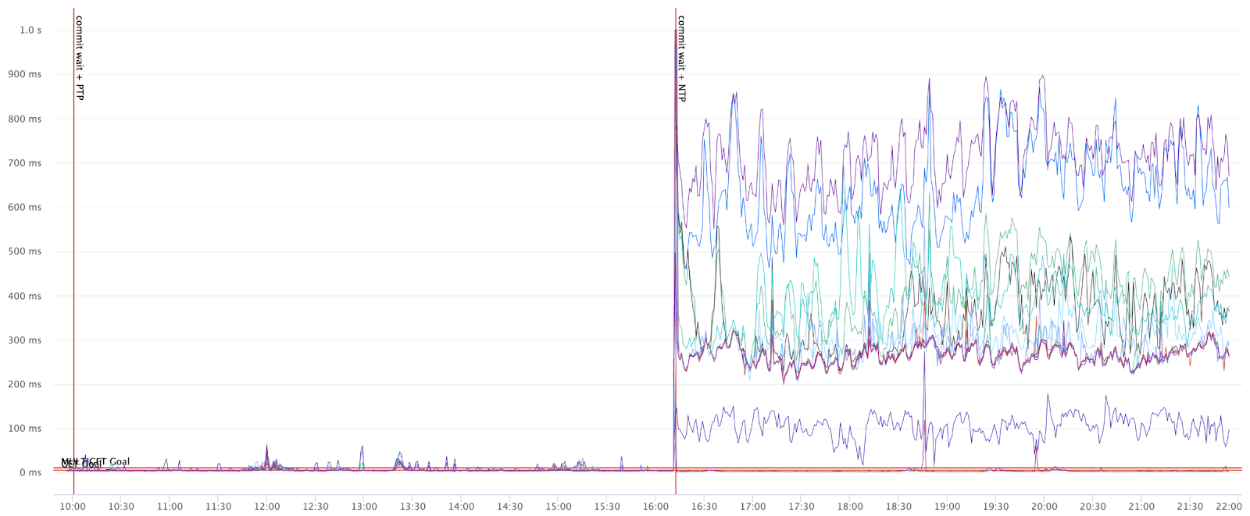
Linearizability latency PTP vs NTP
Notes:
PTP 100 times better

Slide 11
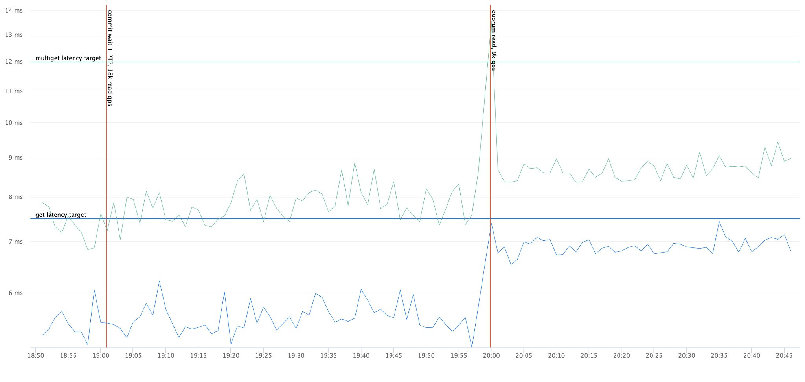
PTP commit-wait vs Quorum reads
Notes:
And this is the graph of PTP commit-wait vs QR latencies. are comparable.
However to achieve this we had to introduce 2 assumptions:
* All quorum reads are local.
* We had to lower QPS 2 times. Which directly translates in more hardware required.

Slide 12
Timing Infrastructure
Notes:
So we got our use case. Let's talk about timing infra

Slide 13
Open Source
Notes:
When we thought about state of the art timing infra we wanted everyone to benefit from our research.
Everything you will see was already or will be open sourced in the near future.

Slide 14
Time Appliance Project
Notes:
But instead of simply implementing, pushing to github and calling it a day we started TAP.

Slide 15
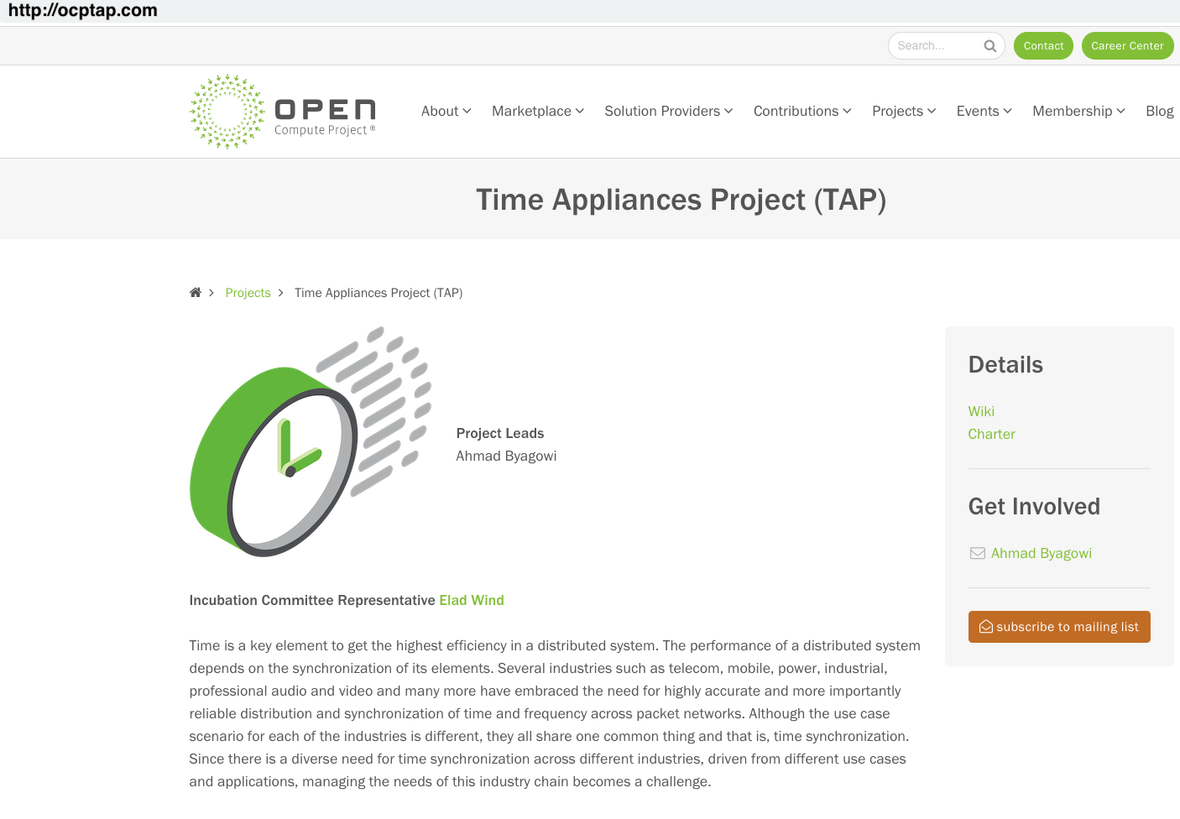
Timing infrastructure. Open source
Notes:
We created the website ocptap.com and everyone is welcome to join and contribute to the project.

Slide 16
Timing infrastructure. Open source
https://global.gotomeeting.com/join/565185493
Notes:
Defined 5 Workstreams
Weekly presentations
Including SiTime, Nvidia, Google, Keysight and more

Slide 17
Timing infrastructure. Open source
http://ocptap.com
and
https://github.com/opencomputeproject/Time-Appliance-Project
Notes:
Everything is open sourced under OCP and there are several vendors producing off the shelf versions

Slide 18
Timing infrastructure
No Multicast -> Unicast
No boundary clocks
Transparent clocks all the way
Hardware timestamps
Notes:
Before we go to the exact implementation I just wanted to mention that a lot work work was done around these DC requirements.
* Multicast is not very common in DC area. So we use unicast
* Boundary clocks add complexity and require proprietary implementations on network equipment
* Transparent clocks however work almost on every modern network devices and they are crucial for a high precision
* Hardware timestamps on all – server and client hardware.

Slide 19
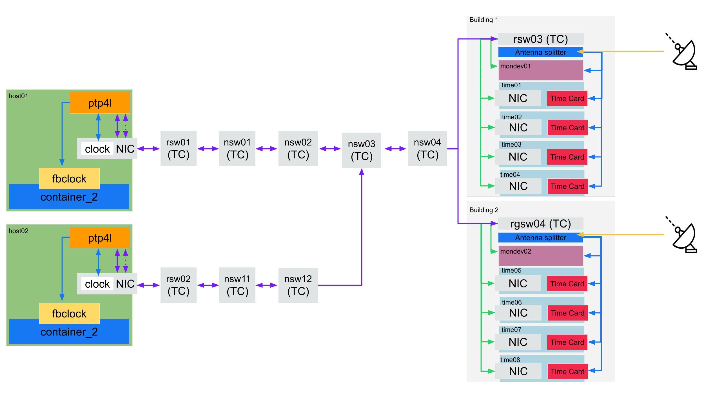
Timing infrastructure
Notes:
3 Major parts

Slide 20
Hardware

Slide 21
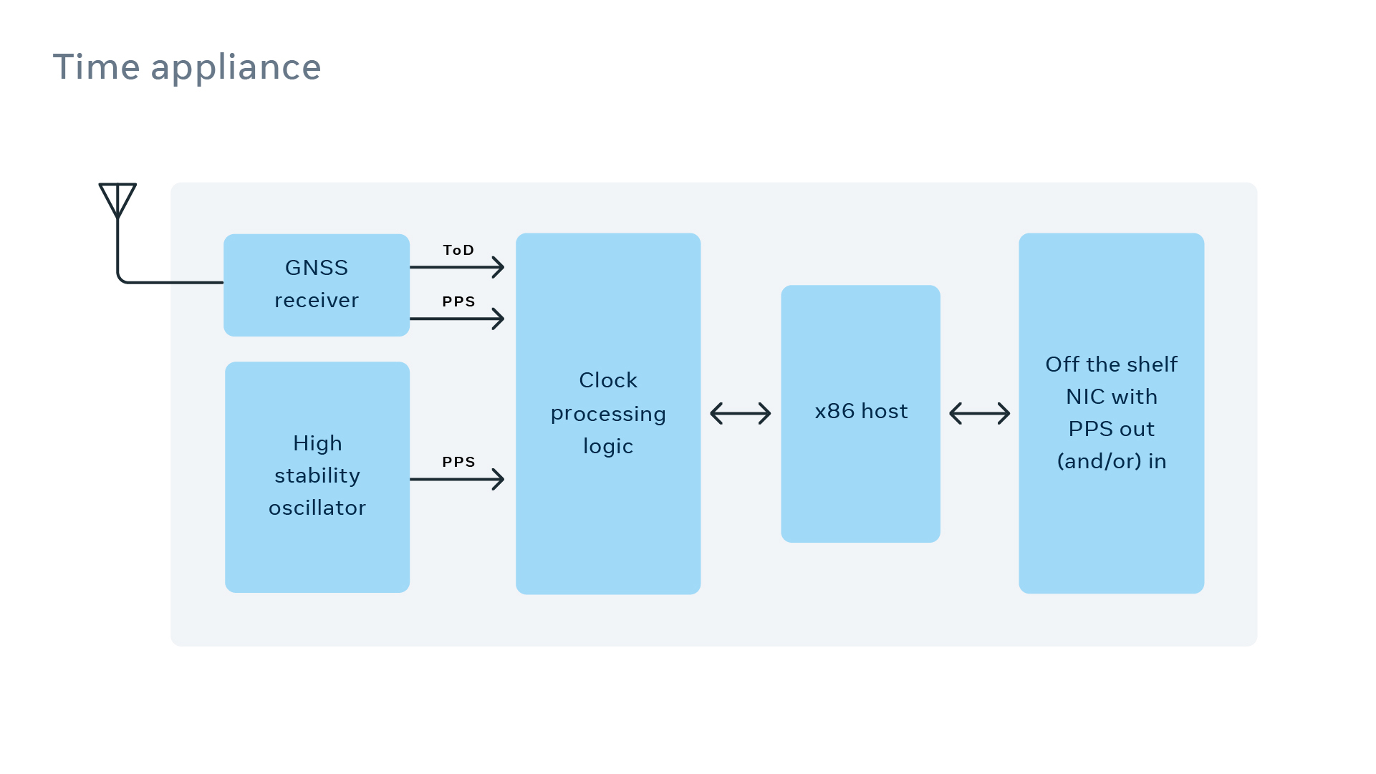
Timing infrastructure. Hardware

Slide 22
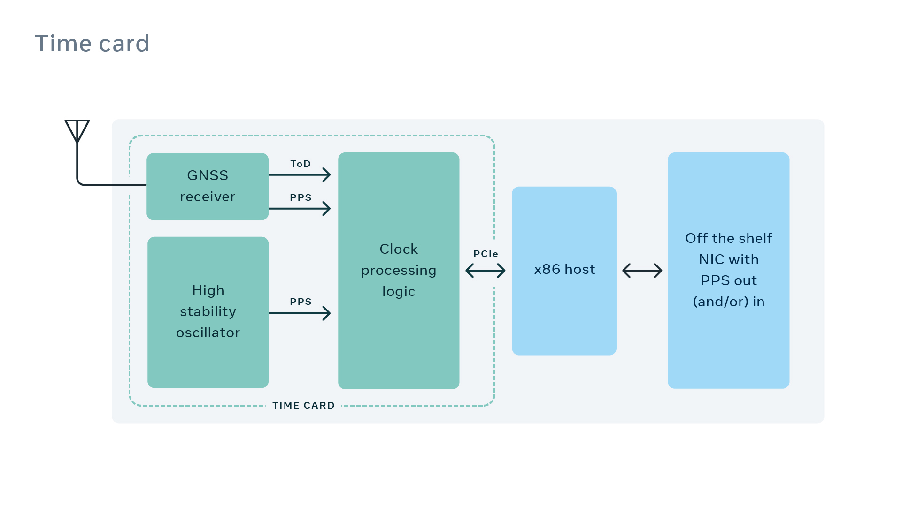
Timing infrastructure. Hardware

Slide 23
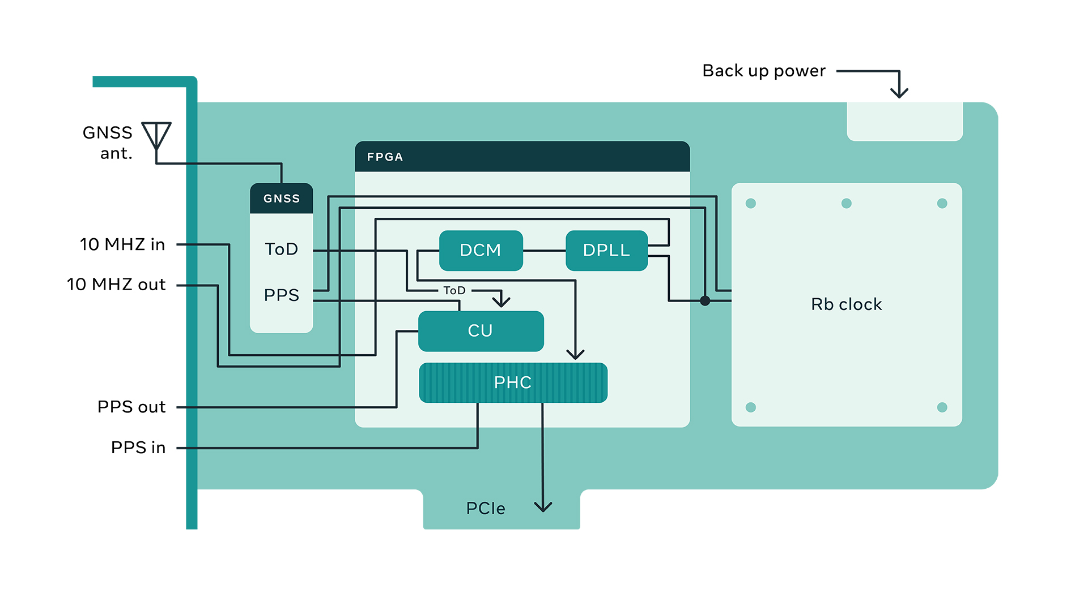
Timing infrastructure. Hardware

Slide 24
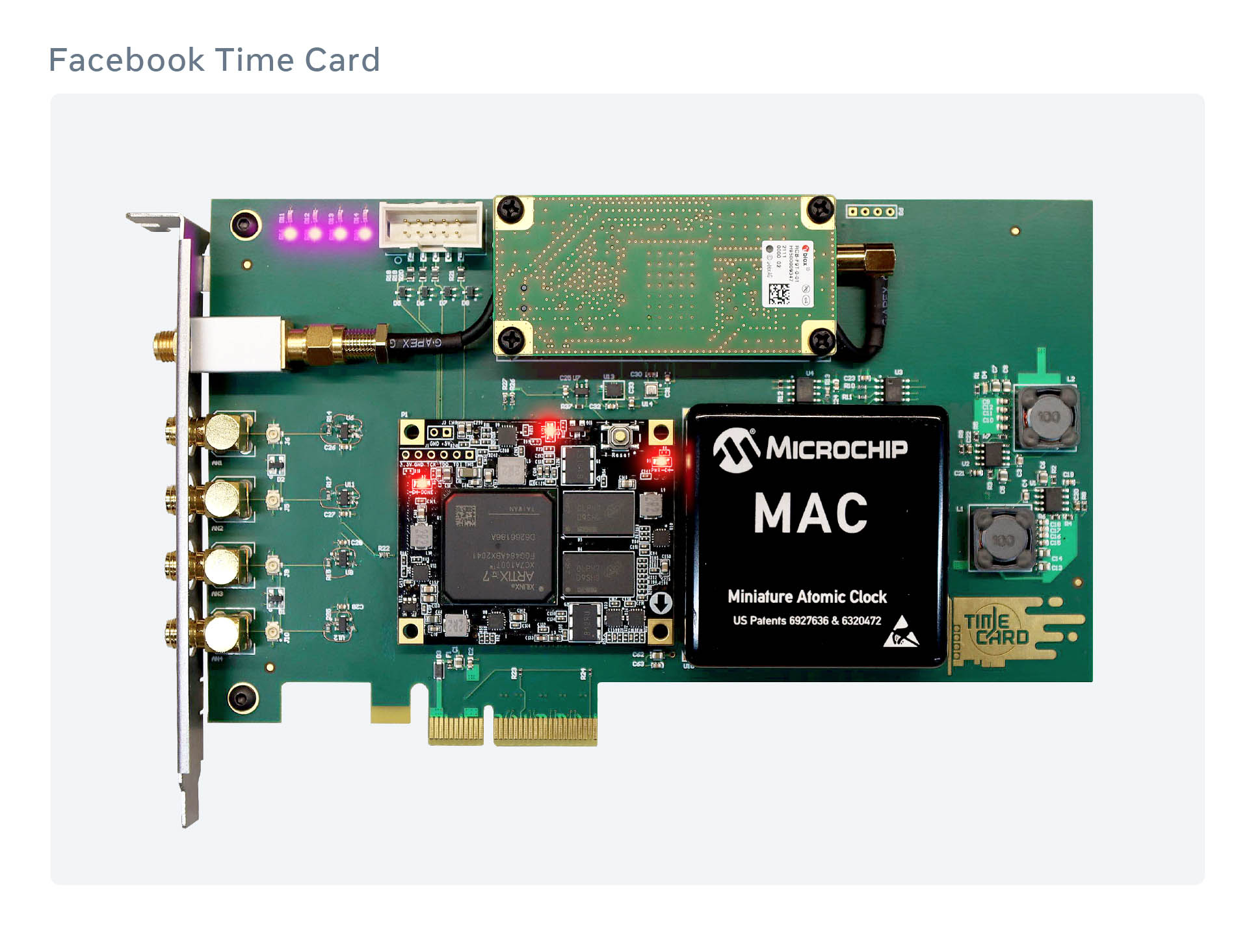
Timing infrastructure. Hardware

Slide 25
Timing infrastructure
http://timingcard.com
Notes:
Everything is open sourced under OCP and there are several vendors producing off the shelf versions

Slide 26
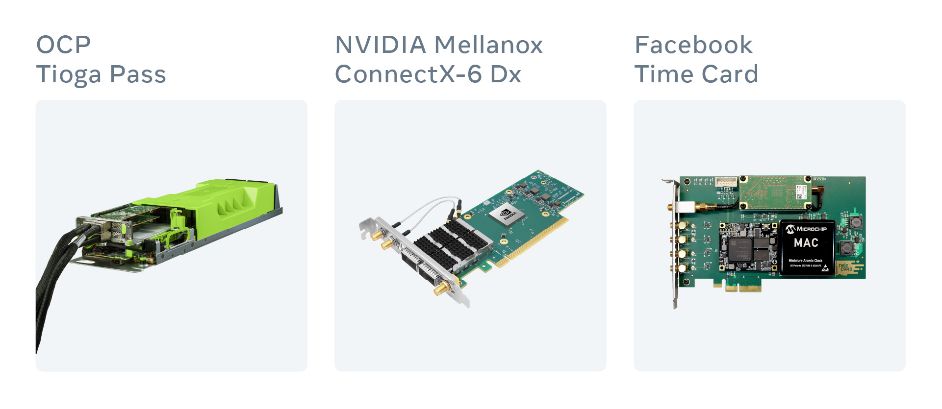
Timing infrastructure. Hardware
Notes:
Hardware-wise to build your own Time appliance we just need to connect 3 Major components together
x86 Chassis, a NIC and the Time Card.

Slide 27
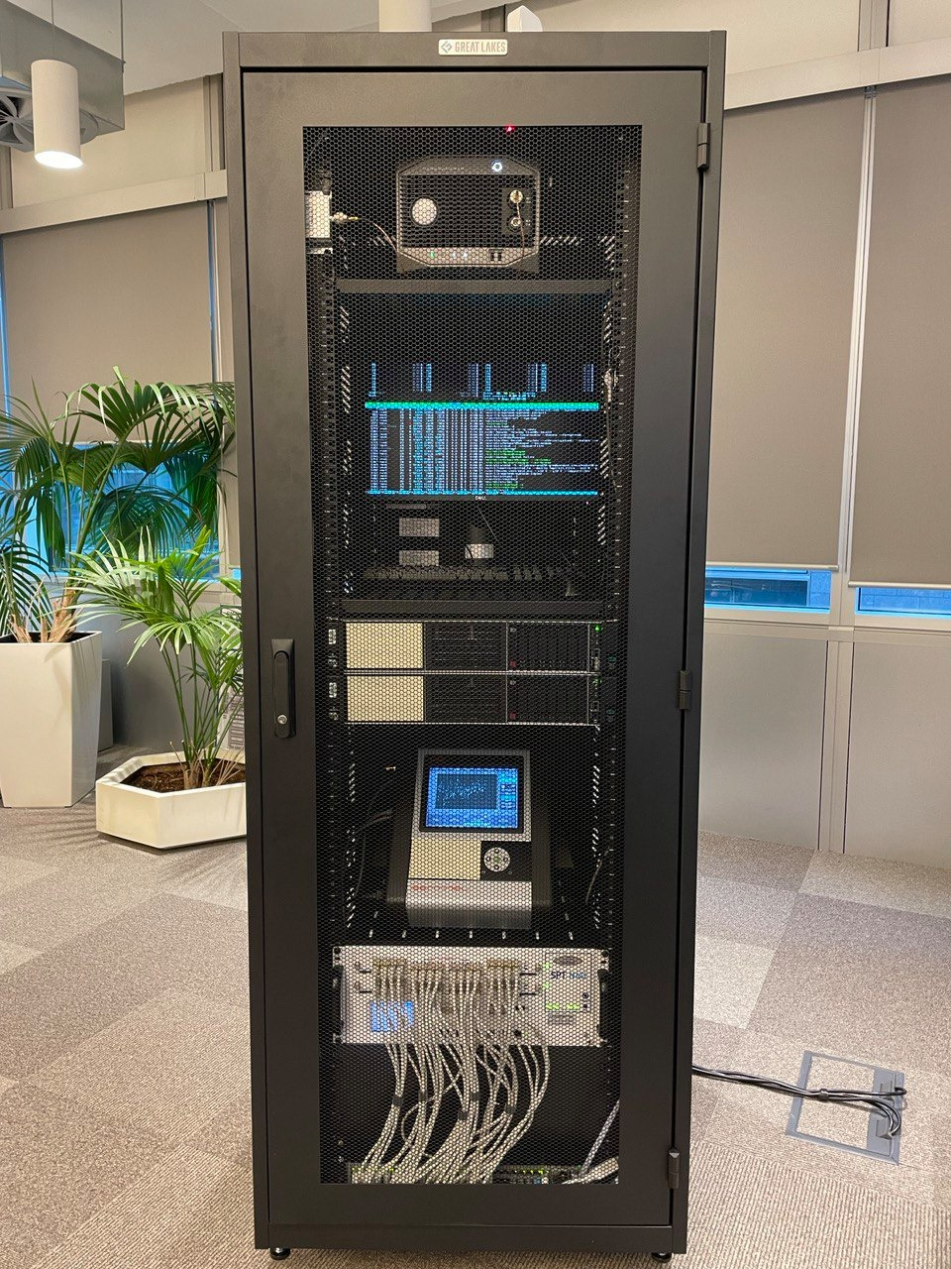
Timing infrastructure. Hardware
Notes:
That’s what's we've done. Put everything together, add bunch of measurement equipment and ran bunch of tests.

Slide 28
Appliance software
Notes:
However one pretty important is still missing. A software which actually runs as NTP or PTP server.

Slide 29
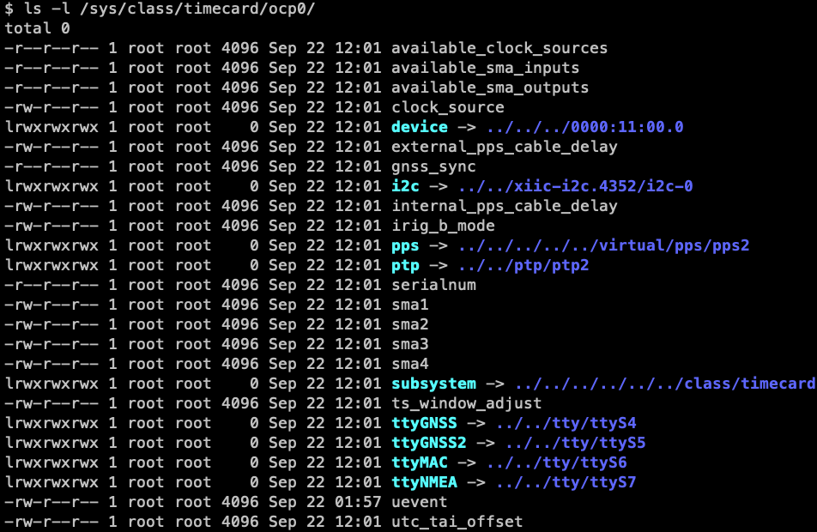
Timing infrastructure. Software
Notes:
In our case we use Linux Centos 8
The latest Linux kernel has a time card driver included.
It will expose very many useful interfaces such as:
PTP clock, Serial devices of GNSS receiver, atomic clock and a lot more

Slide 30
Timing infrastructure. Software
Notes:
In Case of Chrony it's very simple. Just Specify PTP device as a reference clock
For PTP we first need to copy time from Time card to the NIC.
If 1 extra microsecond is fine for your purpose – just use phc2sys.
If you require nanoseconds precision – ts2phc is a better choice but requires PPS cable

Slide 31
Timing infrastructure. Software
http://opentimeserver.com
Notes:
Detailed description of building your own open time server can be found in our github repository. Short link is opentimeserver.com

Slide 32
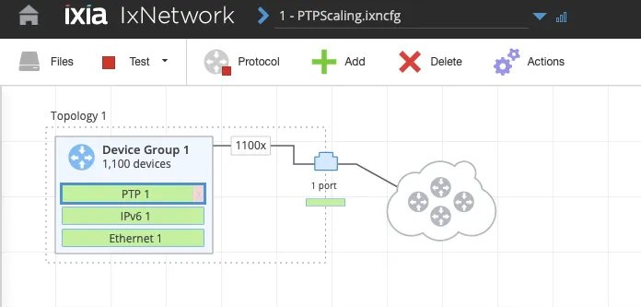
Timing infrastructure. Software
Notes:
Popular open source PTP server for Linux

Slide 33
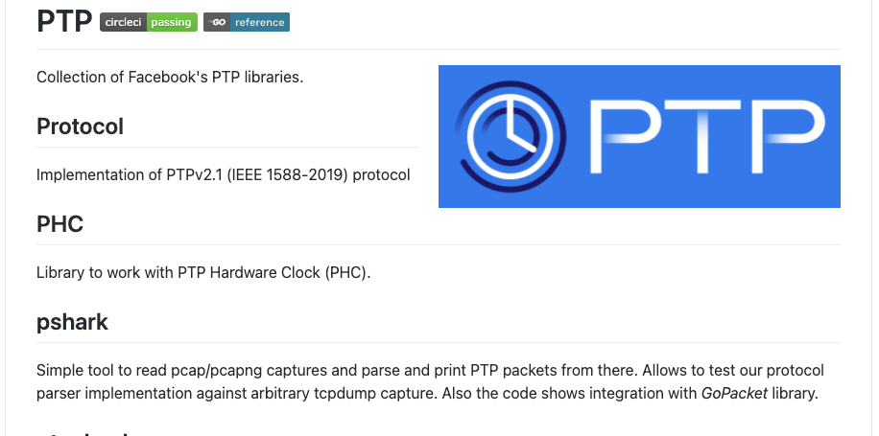
Timing infrastructure. Software
Notes:
So we had to write our own Scalable unicast PTP server.

Slide 34
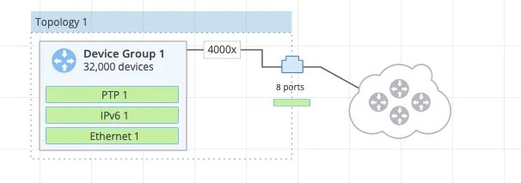
Timing infrastructure. Software
Notes:
And with that we were able to max out our IXIA at 32k client with 1Hz frequency

Slide 35
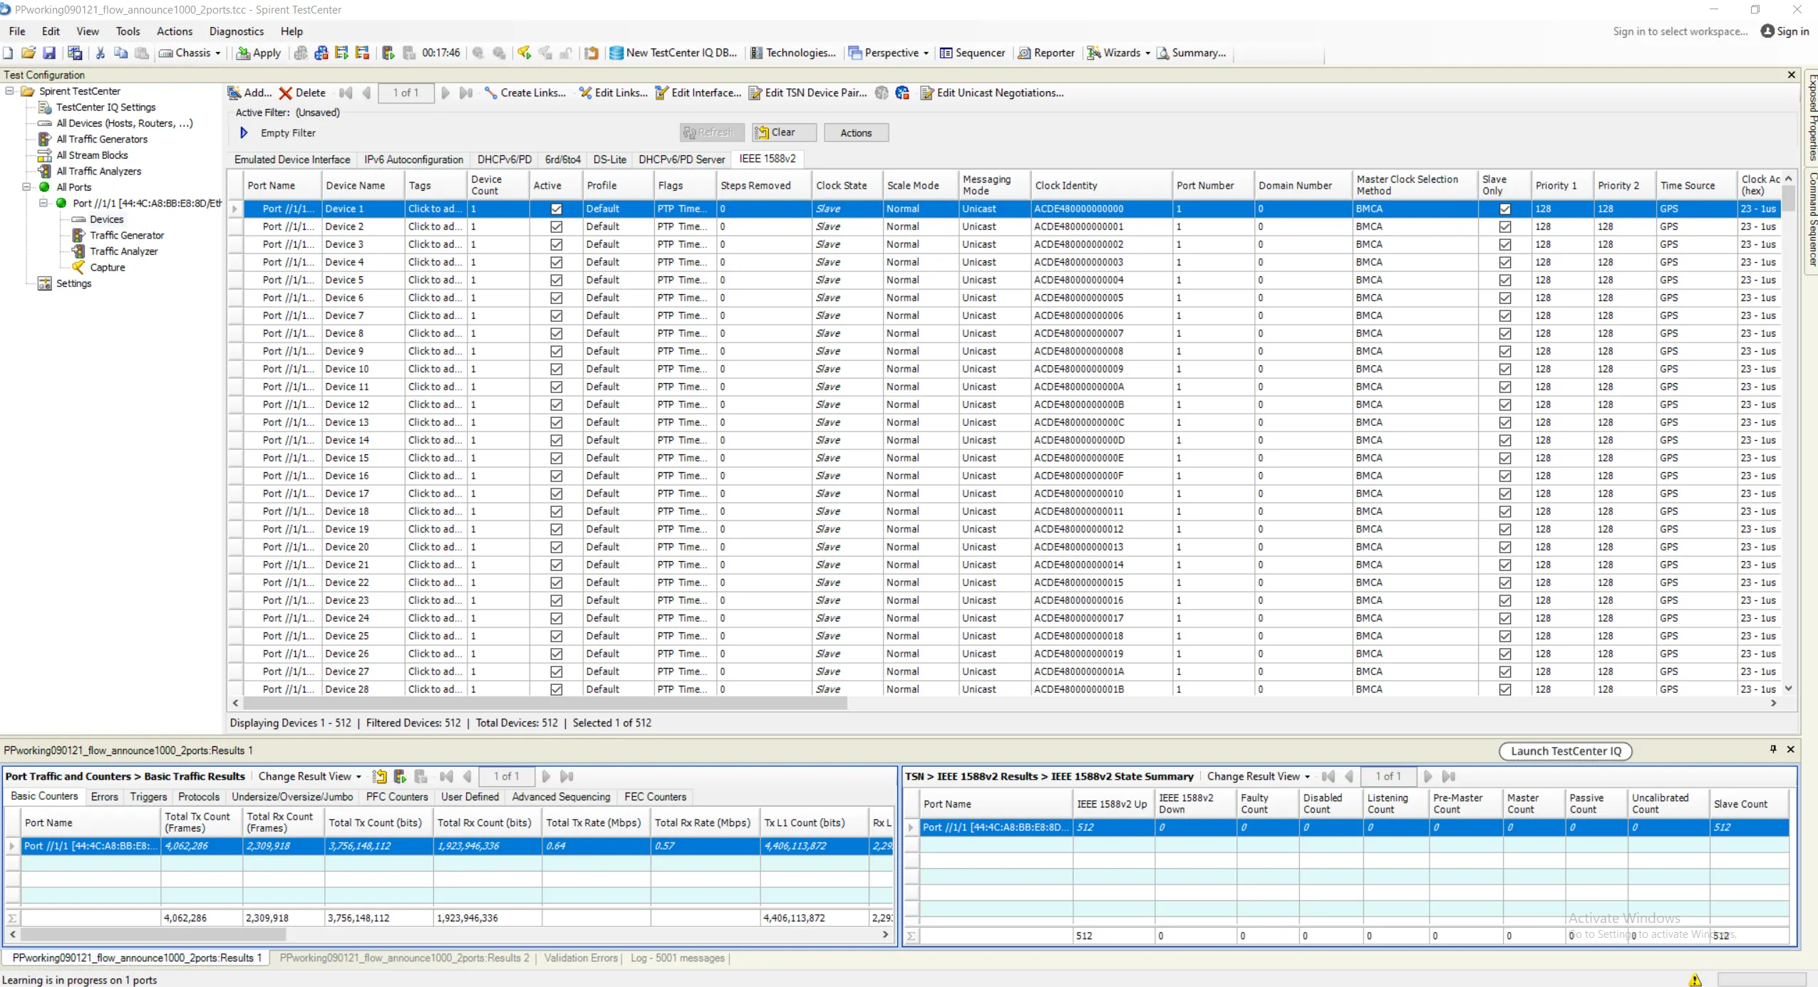
Timing infrastructure. Software
Notes:
We had to bring a heavy gun.
Spirent N4U which is capable of generating 32Gib of PTP traffic.

Slide 36
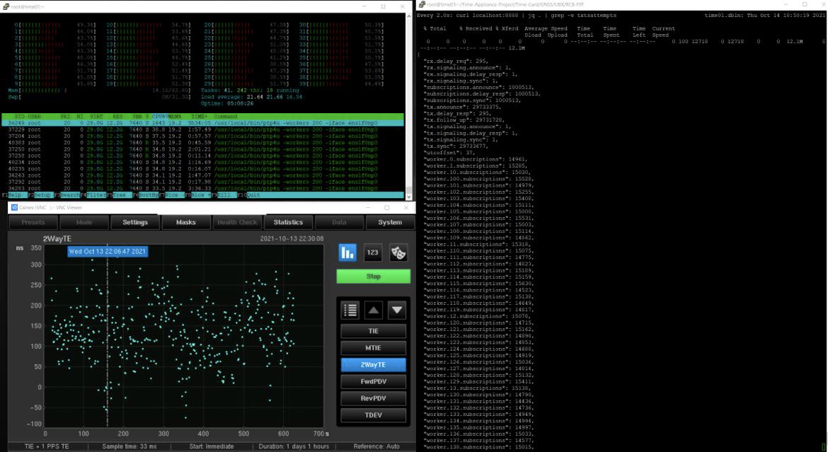
Timing infrastructure. Software
1M 1Hz clients
Notes:
Using Spirent N4U we were able to generate up to 1.2M PTP clients
and handle them on our Open Time Server without any affect on the precision.
This was confirmed using Calnex Sentinel and N4U IEEE1588v2 clients.
This practically means we can handle entire DC load using just 1 device
But we will have more

Slide 37
Timing infrastructure. Software
https://github.com/facebookincubator/ptp
Notes:
The server is now available on

Slide 38
Transparent clock
Notes:
Now let's switch to the network part of the architecture.
To get maximum out of the PTP its helpful to start using Transparent clock

Slide 39
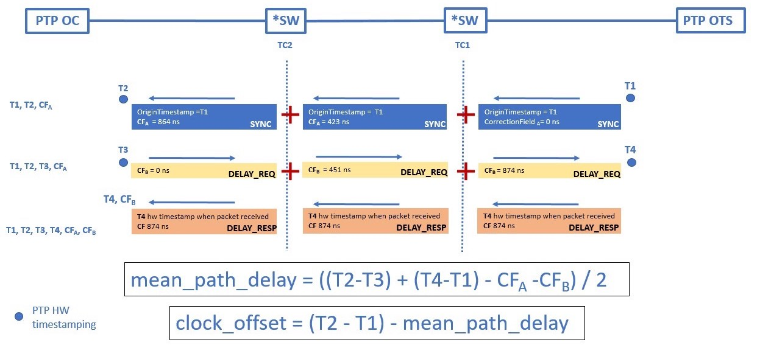
Timing infrastructure. Transparent Clock
Notes:
Transparent clock is a fancy name for the correction field in Sync and Delay Request packets. Every time these packets come through TC capable switch the field gets incremented to account for time packet spent on the ASIC.
It's included in timestamp computations which allows to bring precision to single digit nanoseconds.

Slide 40
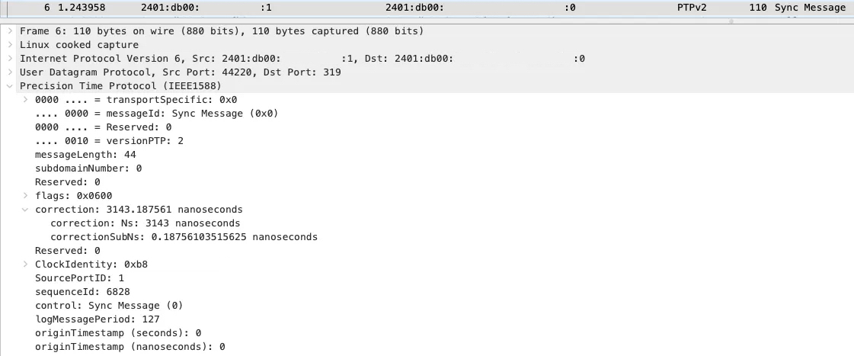
Timing infrastructure. Transparent Clock
Notes:
Here is an example of the PTP sync message with the Correction field filled.

Slide 41
Client software
Notes:
We brought precision and accuracy to the nanoseconds level. But it's all for nothing if client can't use it.

Slide 42
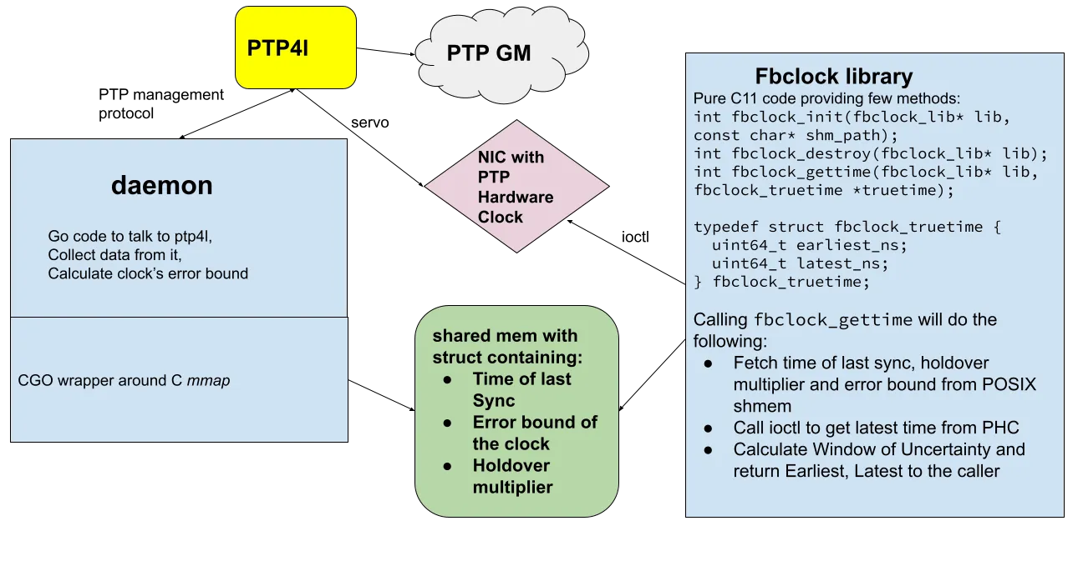
Timing infrastructure. Client software
Notes:
Client don't only care about time. They also care about window of uncertainty.
We implemented a library called FBclock which provides that. It allows to estimate window of uncertainty with 6 9s guarantee.
It interacts with PTP client software via shared memory interface, which allows handle enormous number of requests and use in the containers and virtual machines.

Slide 43
Timing infrastructure. Client software
// what customers get​
typedef struct fbclock_truetime {​
uint64_t earliest_ns;​
uint64_t latest_ns;​
} fbclock_truetime;​
// methods we provide​
int fbclock_init(fbclock_lib* lib, const char* shm_path);​
int fbclock_destroy(fbclock_lib* lib);​
int fbclock_gettime(fbclock_lib* lib, fbclock_truetime* truetime);
Notes:
What we provide is the earliest and latest timestamp in nanoseconds.

Slide 44
Monitoring
Notes:
Being a tier 0 service PTP needs to be constantly monitored and debugged.

Slide 45
Timing infrastructure. Monitoring
Notes:
First thing's first – we monitor the offset, delay and all the important metrics.
And then there is an interface to get the aforementioned window of uncertainty.

Slide 46
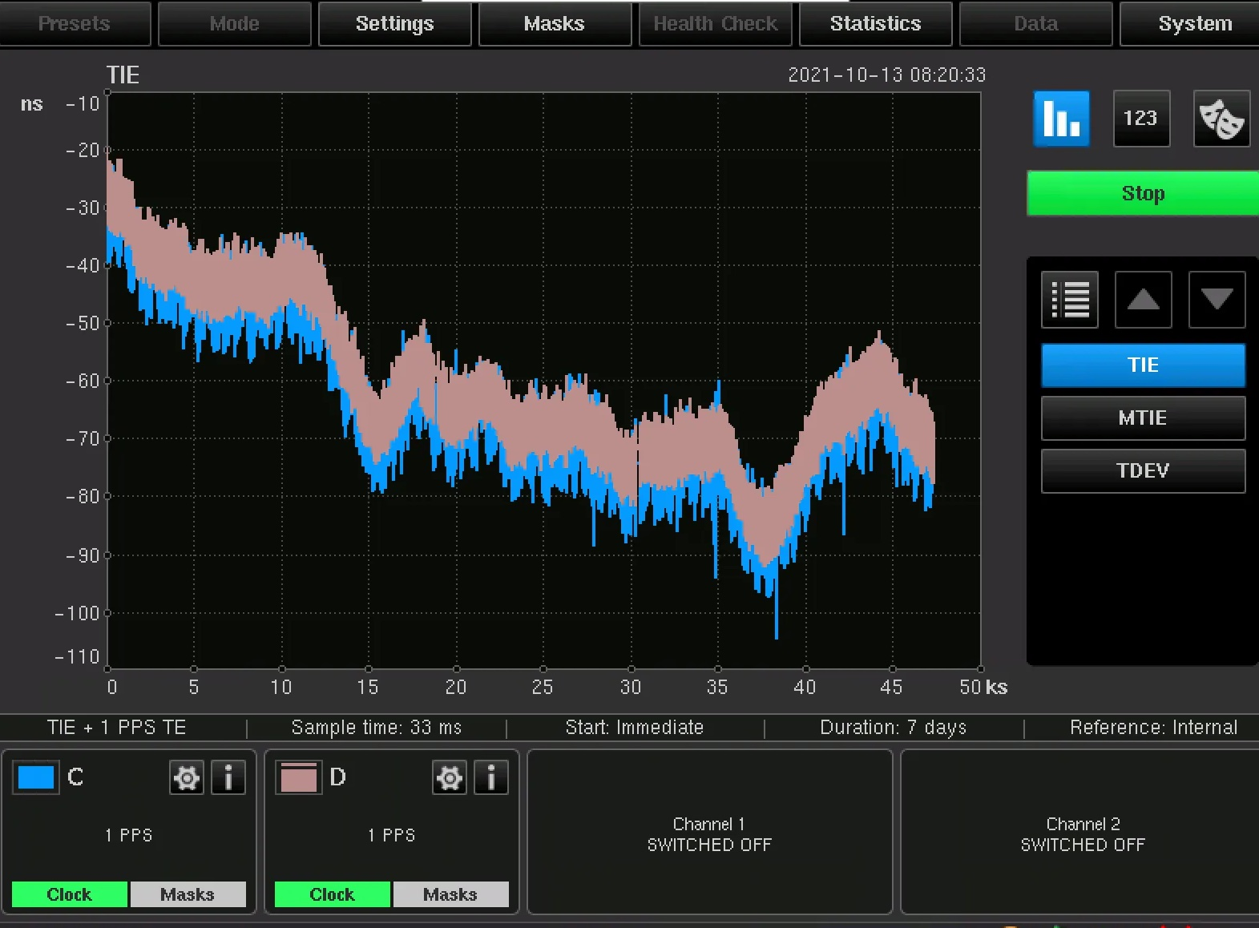
Timing infrastructure. Monitoring
Notes:
And then we perform constant measurement of our Time Appliances.
During normal operations PPS outputs of the Time Appliances stay within 100ns.

Slide 47
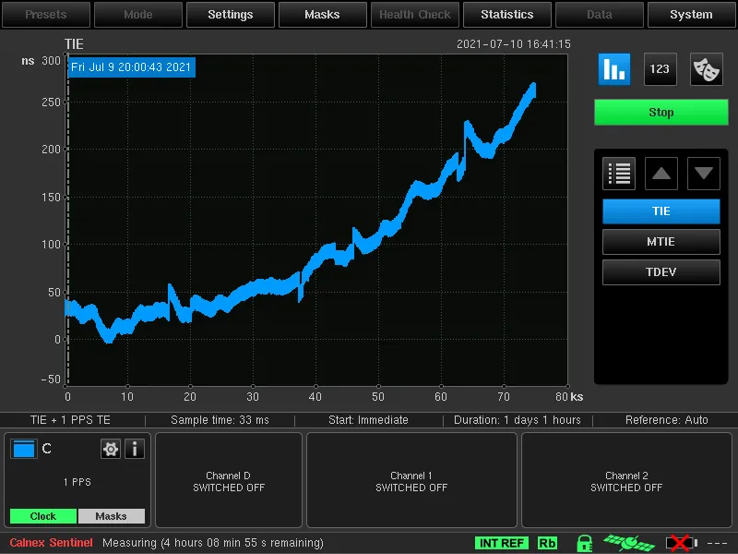
Timing infrastructure. Monitoring
Notes:
In the lab environment we also carefully testing holdover.
Over 24 hours the drift is less than 300ns.

Slide 48
Deployment
Notes:
Facebook has a very large infrastructure and deploying a new tier 0 service like this takes some time.

Slide 49
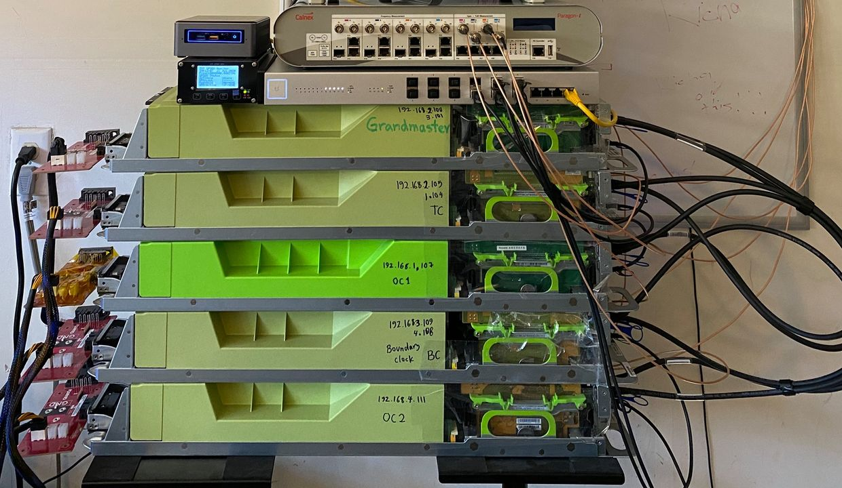
Timing infrastructure. Deployment
Hack in the garage
Lab environment/office testing
Reliability review
1 region pilot
5 regions for X-region users
Rest of the regions

Slide 50
Thank you

