Slide 1
Future Time and Frequency Technologies for Defence
Matthew Aldous
DSTL Quantum Sensing Team
ITSF
2nd November 2021
Crown copyright (2021), Dstl
DSTL/CP134404

Slide 2
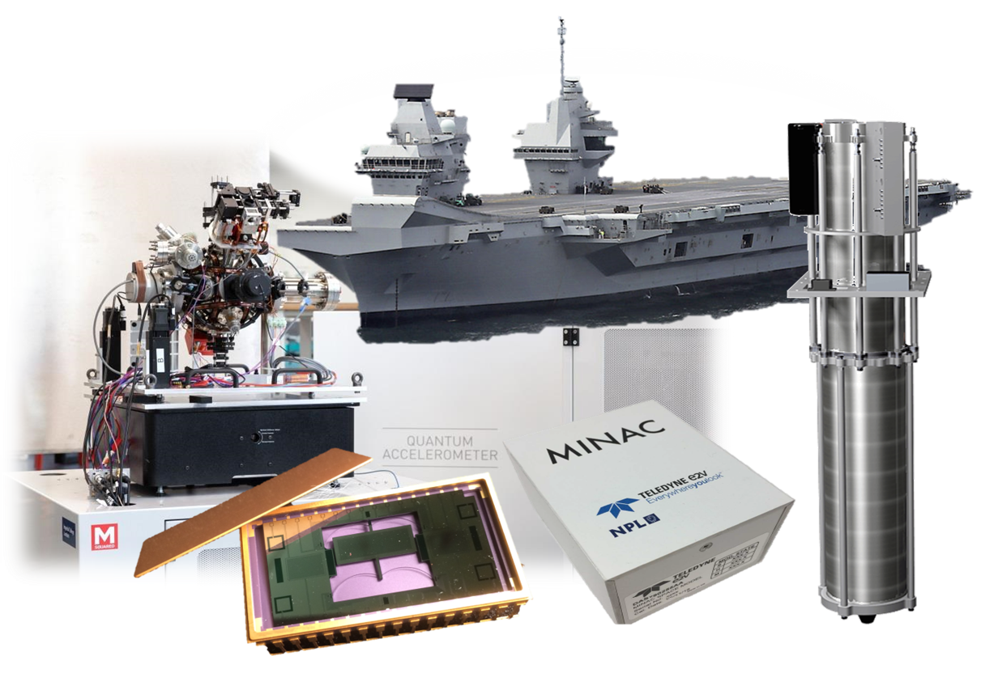
The Dstl Quantum Sensing Project
To be world leading in the engineering of Quantum Sensing Systems; understand the impact for Defence and Security, and pull through technologies from the National Quantum Technology programme.
Attribution: (left to right) cold atom accelerometer: Imperial College / M Squared Lasers, MEMS gravimeter: University of Glasgow / Optocap, MINiature Atomic Clock (MINAC): Teledyne-e2v / National Physical Laboratory, cold atom gravity gradiometer: Teledyne-e2v / University of Birmingham

Slide 3
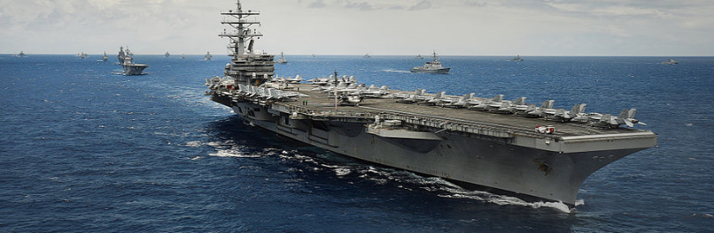
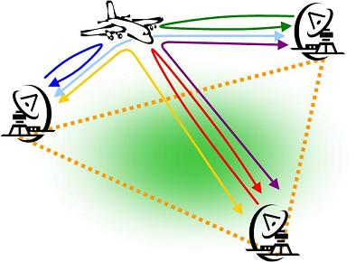



Some Dstl-led challenges in Sensing and Timing
Atomic vapours
Alt-PNT demos 2024 and beyond
Bi-static radar demos
Cold atoms
GNSS resilience
Optical time transfer
Deployable GPS-performance clock

Slide 4
Military Time
Military time analysis – 2015
“GPS is already a ubiquitous location and time source deployed on the battlefield and shall be used as the platform master clock”
Blackett – 2018
“GNSS presents a potential single point of failure affecting multiple services and
applications”

Slide 5
Robustness
All military equipment needs to survive, and often function in an environment with some combination of:
Vibration
Mechanical Shock
High temperature
Low temperature
Fluids – Water, fuel, lubricants
Radiation
Electrical noise – conducted & radiated
Magnetic noise
Fungal ingress (yes- really)
OFFICIAL

Slide 6
Extramural Research
We have colleagues who can help us build for this…
UK OFFICIAL

Slide 7
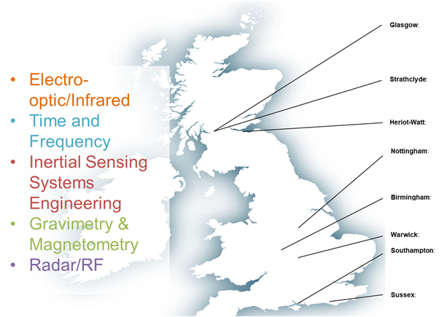
Extramural Research
PhD students
26 studentships at 8 institutions
4 of which are directly applicable to future clocks or enabling technologies
Industrial partners
6 projects at 5 organisations
3 of which are directly applicable to future clocks or enabling technologies
UK OFFICIAL

Slide 8
Intramural Research
…but sometimes there’s no substitute for doing it yourself…
UK OFFICIAL

Slide 9




Motivations: overall
Explore and develop quantum S&T for defence and security applications
First hand experience to disentangle hype from real opportunities
Understand and solve engineering challenges
Support trials and stakeholder demonstrations
Ensure MOD is an intelligent customer
Actively contribute to the UKNQTP and sovereign capability

Slide 10
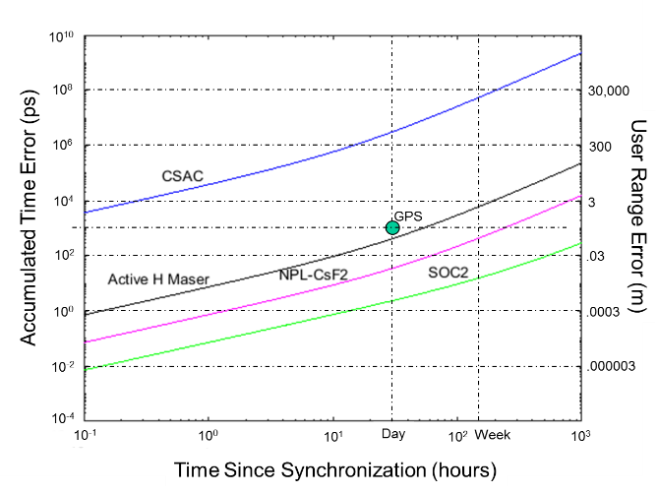



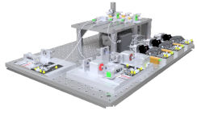

Motivations: in detail
Deployable solutions: optical transitions in atomic vapour
Time-scale development: supporting development of National Timing Centre (NTC)
Preparing for an optically-defined second: transportable optical lattice clock
Intelligent customer: independent test and evaluation capability
100ns
1ns

Slide 11

Time and Frequency Experiments
Miniature Optical Lattice Clock (OLC)
Developed with Uni of Birmingham and NPL
Rack-sized Strontium lattice clock
Developing integration technologies and improving robustness
Strontium Flywheel Clock
Vapour-based optical reference to support OLC during dead-time
Developing strontium vapour cell fabrication technology
Iodine Vapour Optical Clock
Robust optical frequency reference
Exploring practical use of compact and low SWAP laser sources
Future focus on integration and miniaturization
Dstl photo at UK OFFICIAL taken in QS lab.
Notes:
Dstl photo at UK OFFICIAL taken in QS lab.

Slide 12
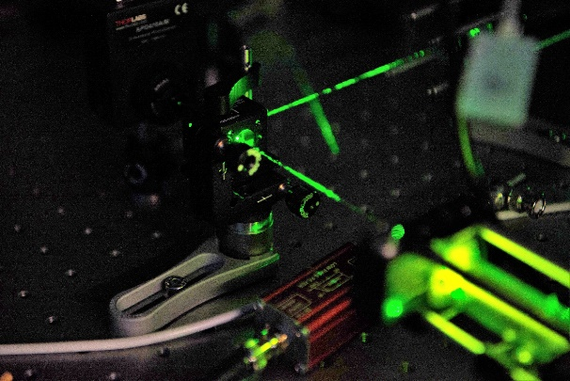
Clock Development: Iodine
Starting point for in-house optical clock development, using Modulation Transfer Spectroscopy in a vapour cell
Aiming for performance superior to Cs beam tube in comparably-sized package
One key objective is to build expertise
Clock laser lock achieved, undergoing optimisation and miniaturisation
Dstl photo at UK OFFICIAL taken in QS lab.
Notes:
Dstl photo at UK OFFICIAL taken in QS lab.

Slide 13
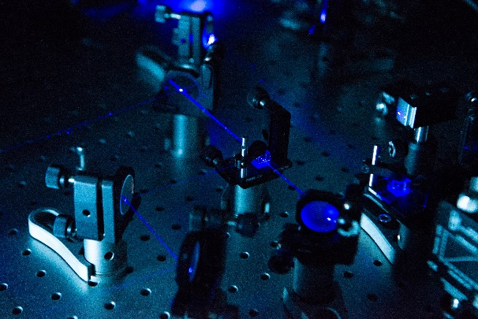
Clock Development: Sr Vapour
Optical frequency standard using intercombination line (689nm) as frequency reference
Low TRL: Sr beam systems exist in the literature, but no vapours
Extremely challenging materials science: high temperature, highly corrosive strontium vapour
Potential synergy with Sr OLC as pre-stabilisation of red MOT laser (“flywheel clock”)
Dstl photo at UK OFFICIAL taken in QS lab.
Notes:
Dstl photo at UK OFFICIAL taken in QS lab.

Slide 14
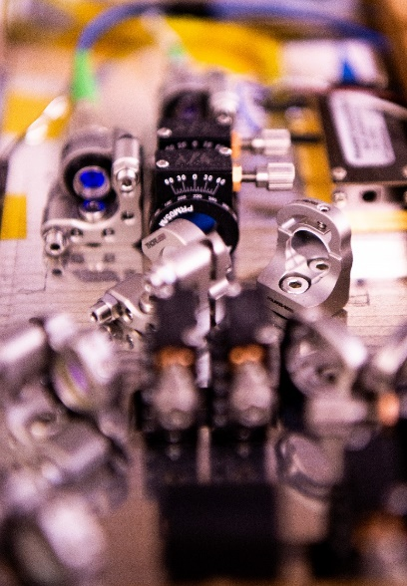
Clock Development: Optical Lattice
Continuation of 5-year project with University of Birmingham and NPL to achieve:
fractional stability of 1x10⁻¹⁵ at 100s
packaging suitable for road transport
low-maintenance operation
System delivery to Dstl enables further development and direct in-house exploitation
Continued support between partners
Dstl photo at UK OFFICIAL taken in QS lab.
Notes:
Dstl photo at UK OFFICIAL taken in QS lab.

Slide 15
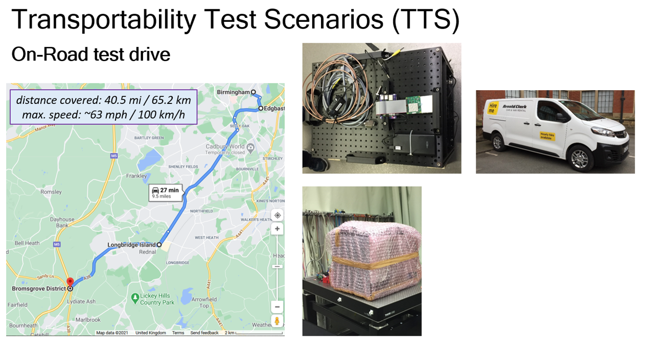
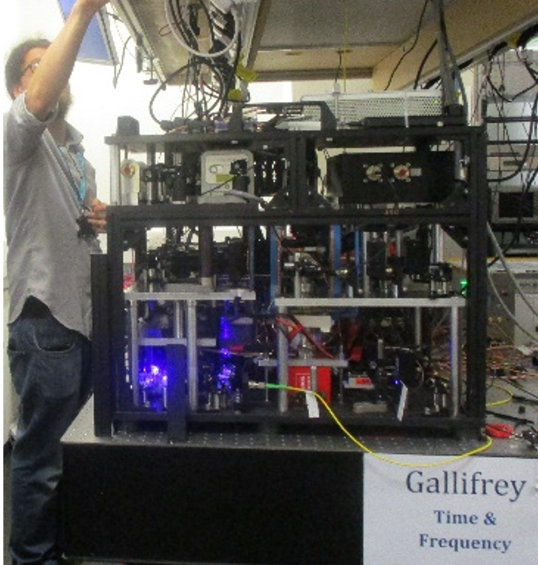
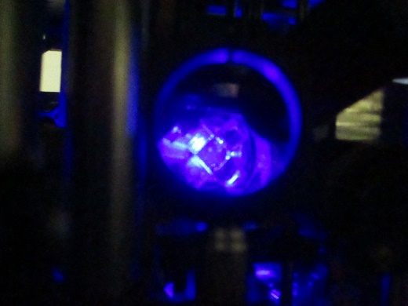
Clock Development: Optical Lattice
Images courtesy of UoB, provided under full rights
Dstl photos at UK OFFICIAL taken in QS lab.
Lattice clock developed in three modules at two sites
All three subsystems demonstrated operating in at least two locations
Transportability test of physics package – lattice trap recovered just 3 hours after a 65km drive
Whole clock now located at Porton for further development and ruggedisation
Notes:
Left: Images courtesy of UoB, provided under full rights. Middle, right: Dstl photos at UK OFFICIAL taken in QS lab.

Slide 16
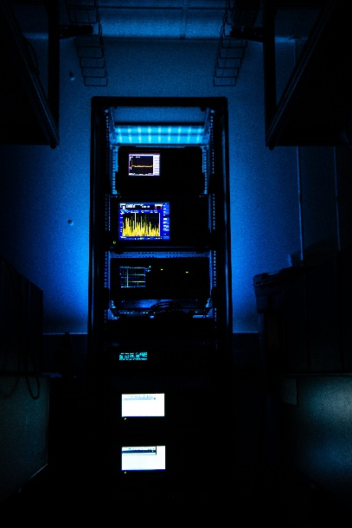
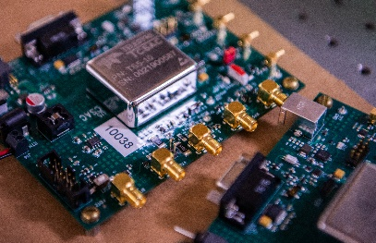
Test and Evaluation
Test equipment
GPS time server for PTP/NTP
GPS disciplined oscillator
Phase noise measurement kit
Cs beam tube references
Commercial cold Rb references
Ultra-stable quartz oscillator
Plans for environmental control to extend test capabilities
Dstl photos at UK OFFICIAL taken in QS lab.
Notes:
Dstl photos at UK OFFICIAL taken in QS lab.

Slide 17
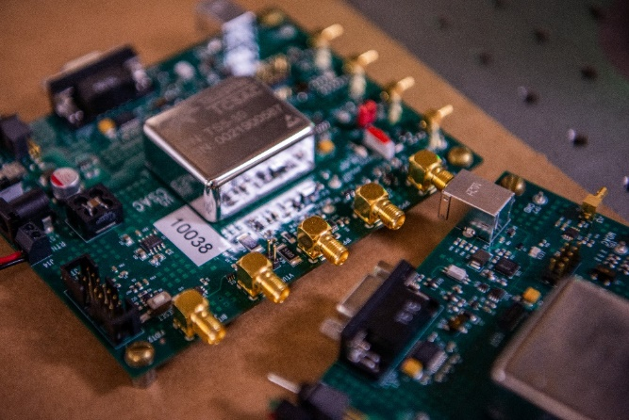
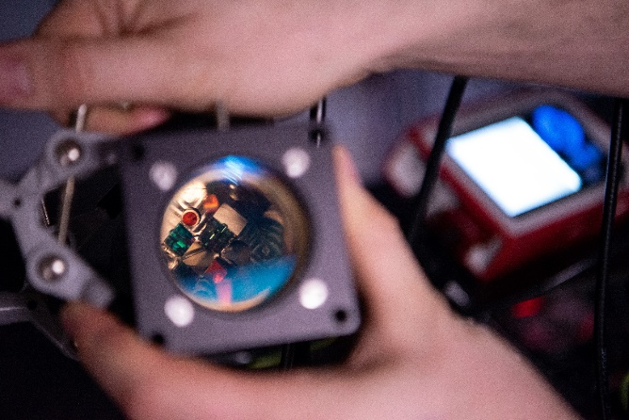
Test and Evaluation
COTS performance and resilience
Specification assurance (now)
Climatic variations (2021/2022)
Vibration resilience (2021/2022)
AC/DC magnetic fields (2021/2022)
Dstl photos at UK OFFICIAL taken in QS lab.
Notes:
Dstl photos at UK OFFICIAL taken in QS lab.

Slide 18
Technology Development Challenges – Common Issues
Common Issues
Potential Solution
Maturing low Technical Readiness Level (TRL) technology is notoriously challenging:
combination of technical complexity of underpinning science;
lack of common, contextual understanding for opportunities and constraints.
Information exchange is hampered by inability to release information on Defence and Security Requirements to external industry and academic parties
Most requirements, Def Stans etc. are higher than OFFICIAL
Academia and Small & Medium sized Enterprise not cleared to receive or hold higher classifications
Establishing an evidence base for comparison and direction of targeted investments against identifiable requirements.
A common ‘language’ is needed to allow technical specialists, industry suppliers and military capability leads to convey opportunities and constraints.

Slide 19
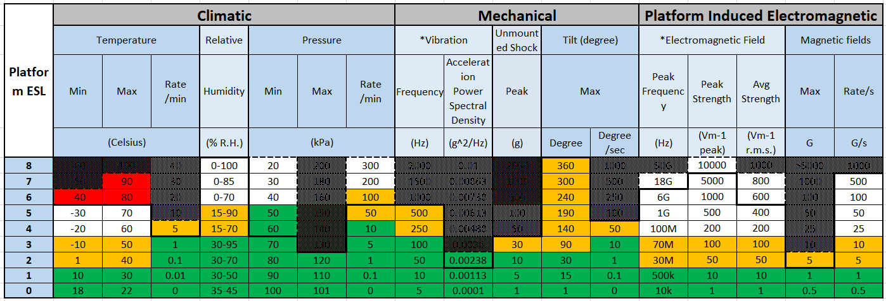
ESL Matrix Mapping Technology Capability to Platform Requirements
Limited capability in platform environment
Technology requires further development to meet platform requirements
Platform requirement profile is mapped onto technology capability, highlighting:
Areas where the technology meets platform requirements
Areas requiring further technology development
Roadblocks, where a technology could be fundamentally limited and unable to meet platform requirements

Slide 20

Quantum technology and DASA
Recently completed focused call on reducing reliance on GNSS
Assessed using Engineering Severity Level (ESL) tool
DASA Open call provides a route for funding

Slide 21
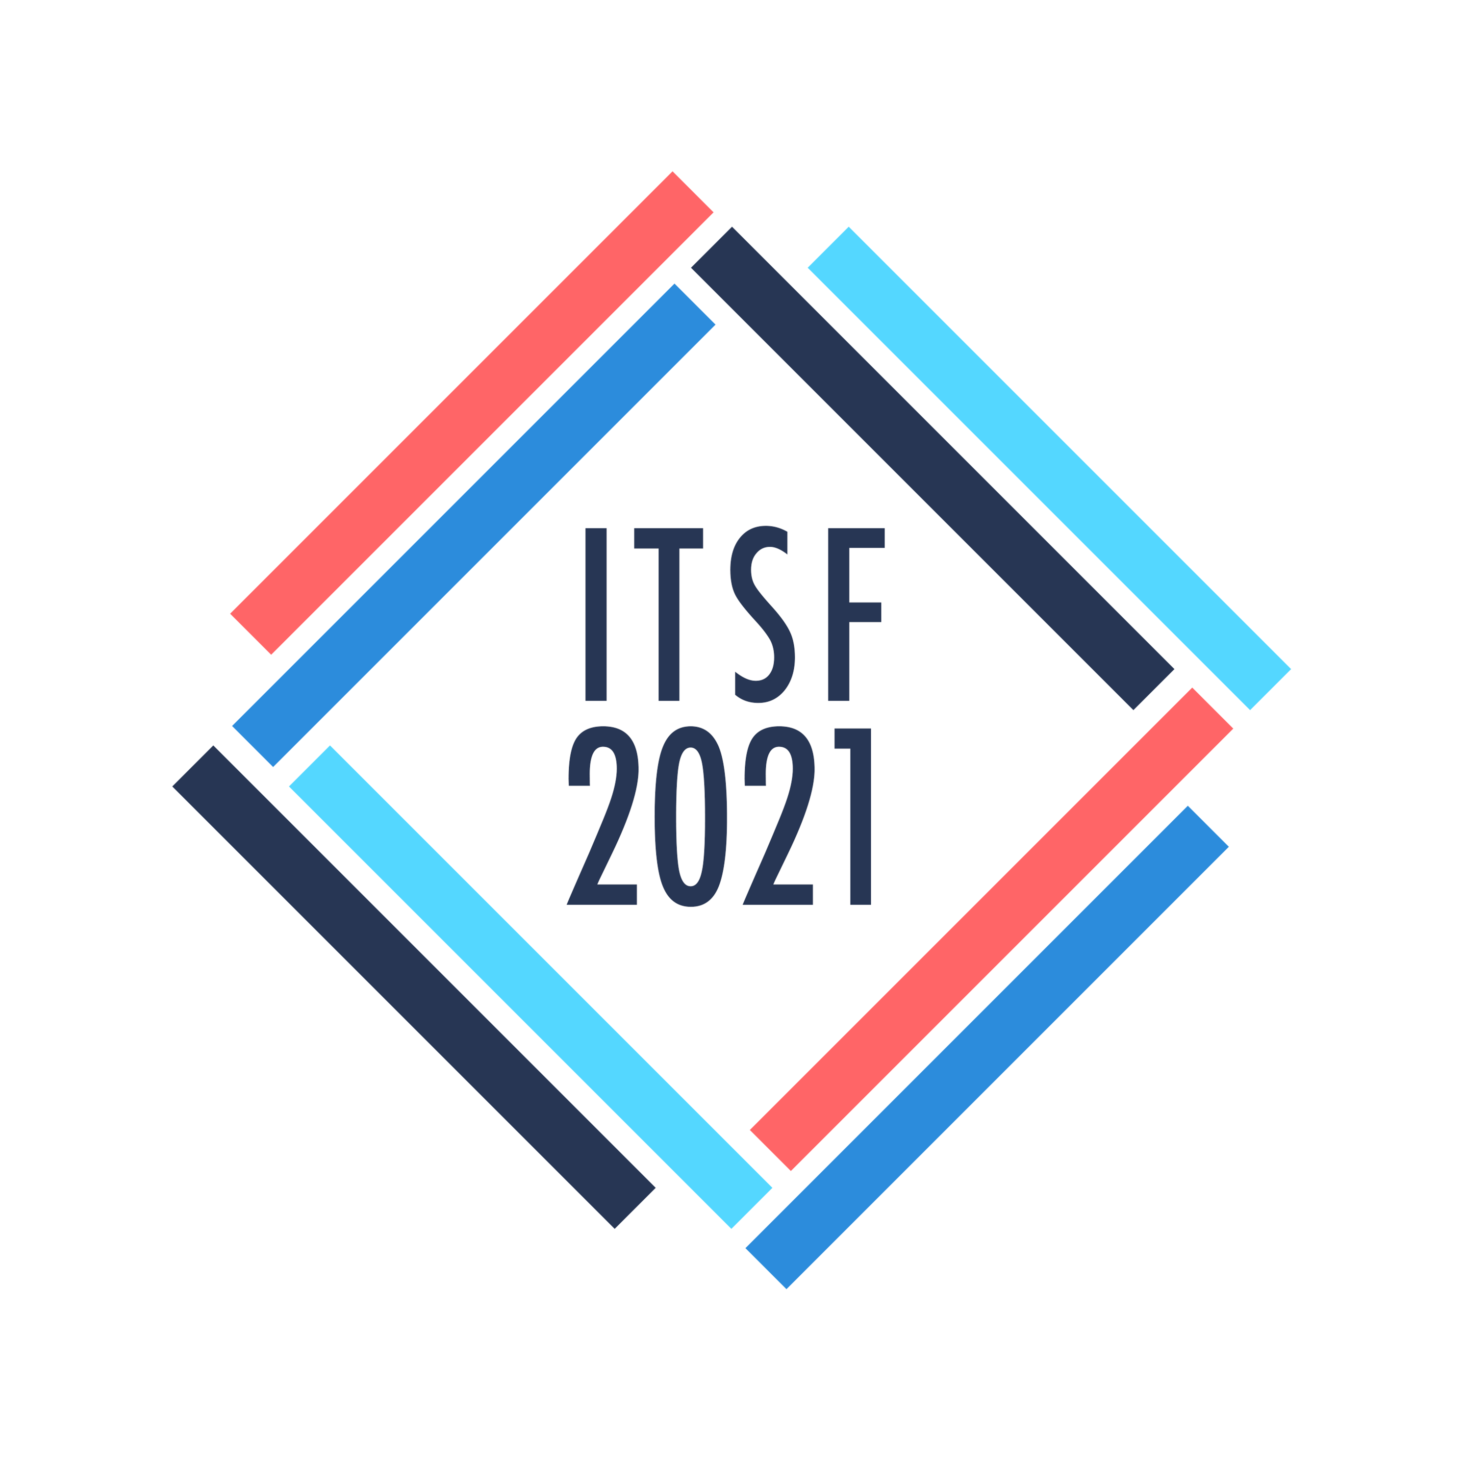

Thank you
If you still have questions…
…come and talk to us at the conference, or
…contact us at QuantumSensing@dstl.gov.uk

Slide 22
Content includes material subject to © Crown copyright (2021), Dstl. This material is licensed under the terms of the Open Government Licence except where otherwise stated. To view this licence, visit http://www.nationalarchives.gov.uk/doc/open-government-licence/version/3 or write to the Information Policy Team, The National Archives, Kew, London TW9 4DU, or email: psi@nationalarchives.gov.uk

